Slide 1
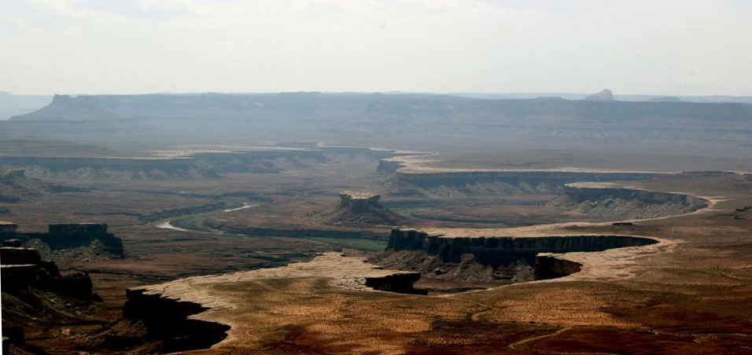
Spinocerebellar Ataxia Type 2:
Discovery of Drugs and Therapeutic Targets
Daniel R. Scoles, Ph.D. Associate Professor
Department of Neurology
February 3, 2016
Disclosures: none

Slide 2
Spinocerebellar Ataxia Type 2 (SCA2)
Patients are characterized by gait ataxia, frontal executive dysfunction, and slow saccades.
SCA2 is a dominantly inherited polyglutamine disorder.
Age of onset varies with CAG length (anticipation).
22 CAGs is normal, >32 is disease-causing.
Moderate ATXN2 CAG expansions → increased ALS risk.
Rare (2-3 in a million) but common in Cuba (3/2000).
Disease of the cerebellum (SCA2 accounts for 13% of ADCA patients).
Characterized by Purkinje cell death.

Slide 3
ATXN2 and interacting proteins
1312 amino acids, 145 kDa
Caspase-3
SBM1
Lsm
SBM2
PAM2
Clathrin
PolyQ
RNA Binding
A2BP1 / FOX1
TDP-43 PABP
DDX6
Staufen
Calcium
InsP3R
EGFR Activation
CIN85
Stress
Granules
Synapse formation
Endophilins

Slide 4
Drug Discovery Strategies
Target-based screens
vs
Target-agnostic screens
Elder et al., The discovery of first‑in‑class drugs: origins and evolution. Nature Reviews Drug Discovery 13:577-587; 2014.

Slide 5
Hypothesis
Lowering of ATXN2 expression may be therapeutic for SCA2
Gain of toxic function
Gene dose relationship: SCA2 phenotypes are worse in patients or mice with two copies of the gene.
Disease reversibility in mouse models.
Notes:
Because a definitive cellular pathway mediating mutant ataxin-2 function related to SCA2 onset is not known, we are pursuing a strategy to downregulate ATXN2 expression or ATXN2 mRNA stability.
In so doing we are characterizing the expression control regions of the ATXN2 gene.
This approach is supported by several observations providing the study rationale: Gene dosage is important in SCA2 as patients homozygous for the mutation show a more severe phenotype. This also supported by experiments in transgenic mice as doubling of transgene dosage results in significantly earlier onset of SCA2 mouse disease phenotype.
Knockout of ATXN2 in mice on the other hand does not result in major CNS dysfunction, but causes obesity, a potentially beneficial side-effect as SCA2 patients are very often underweight.
Additionally, downregulation of mutant SCA1 or SCA3 alleles in rodents even after disease onset resulted in reversal of the phenotype.
In one study an shRNA was used to target total ATXN1 expression resulting in improved phenotype.

Slide 6
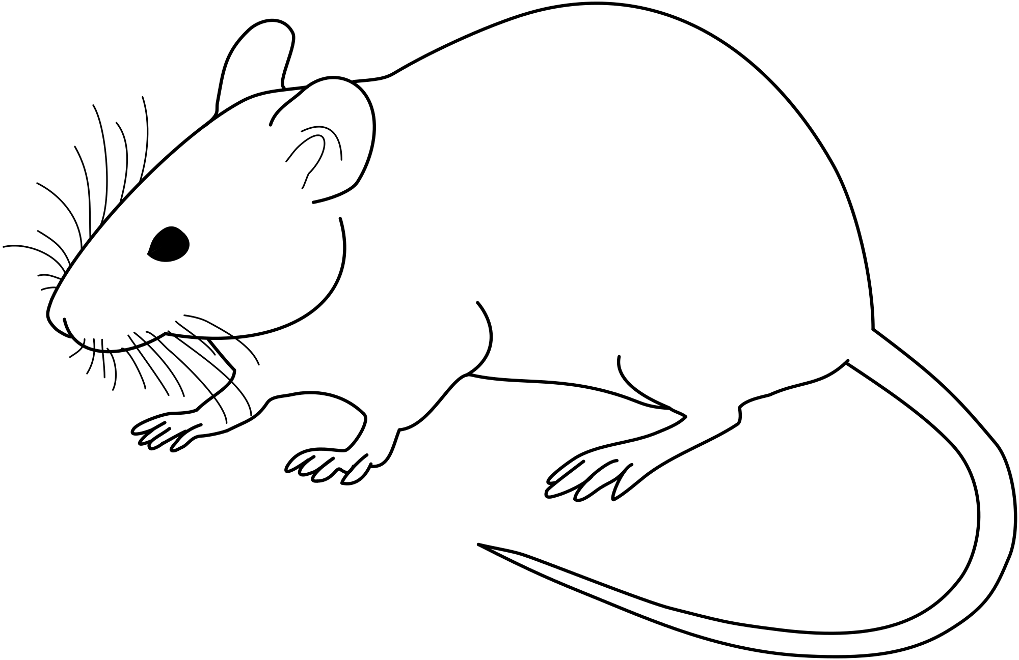
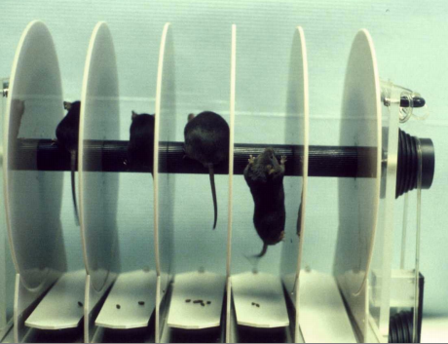
SCA2 Mouse Models
Transgenic
SCA2 BAC
Pcp2-ATXN2 [Q127]
BAC ATXN2 [Q72]
Cerebellar Rgs8
Rotarod Performance
WT
* *** ** ***
Q72
WT
Relative Expression (%)
WT
Q127
Q127
4 8 12 24 36
Age (weeks)
Dansithong et al., 2015
Hansen et al., 2013

Slide 7
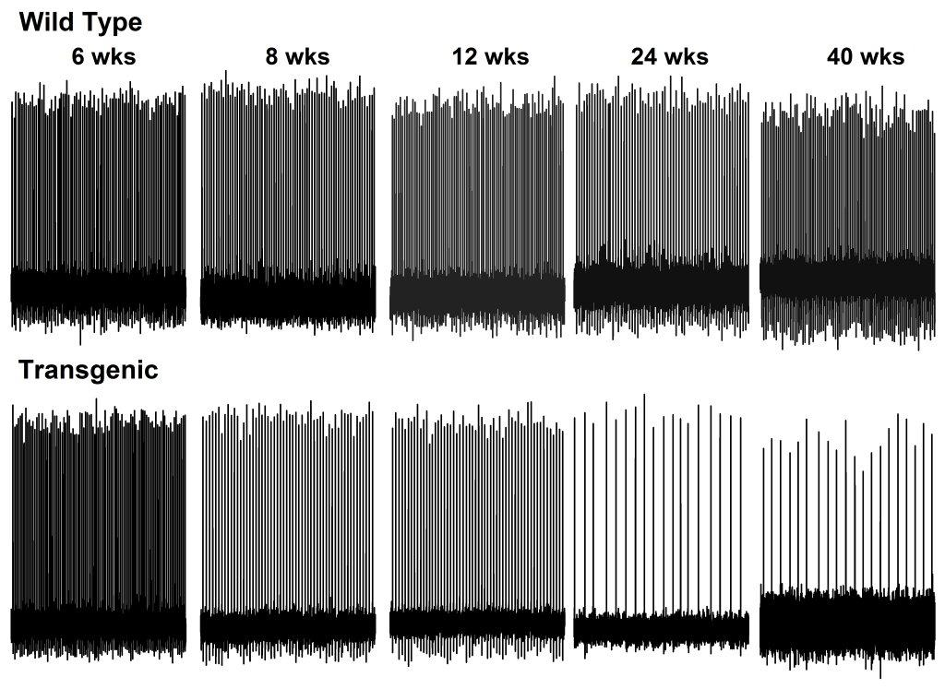
SCA2 Mouse Purkinje Cells
Purkinje cell firing frequency
Q127
Hansen et al., 2013
WT TG
Pratap Meera

Slide 8
A Treatment for SCA2
COMPOUND SCREENING
TARGETING CALCIUM
ANTISENSE OLIGONUCLEOTIDES (ASOS)
STRESS GRANULES

Slide 9
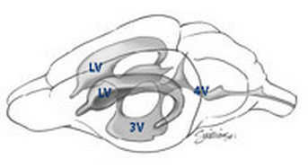
ATXN2 Antisense oligonucleotide (ASO)
Target based approach
ASO treatment improved. . .
Molecular phenotype
Intracerebroventricular (ICV) Injection
Rgs8 & Pcp2
expression improved
Rotarod
performance
JAX
Right Lateral Ventricle
PC firing frequency
ASO
Notes:
Here is the structure of the ASOs we are using and how they work.
These ASOs are the MOE gapmer variety
They have modified nucleotides, including the O-methoxyethyl modification at the 2’ position, and a phosphorothioate backbone.
The MOE modification enhances ASO stability and inclusion of a 10 bp gap of regular phosphorothioate ensures RNase H destruction of target mRNAs

Slide 10
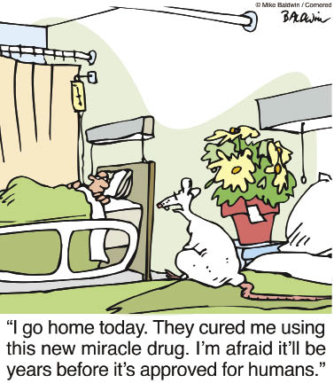

Slide 11
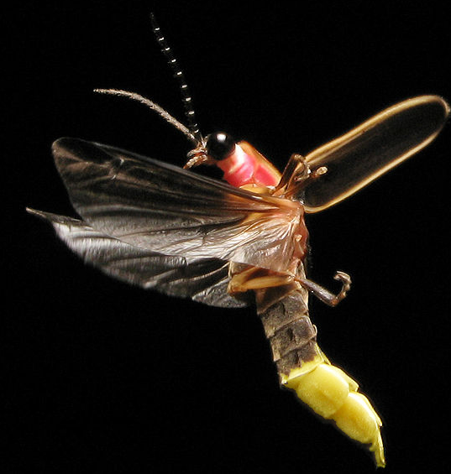
ATXN2 Screening Construct
5’-UTR
ATXN2
Promoter
Luc
ATXN2
3’-UTR
Downstream
-1062
+1
3’-UTR end at 598 bp
after stop
3’-UTR end at 1012 bp
after stop
ATG
(+163)
Firefly

Slide 12
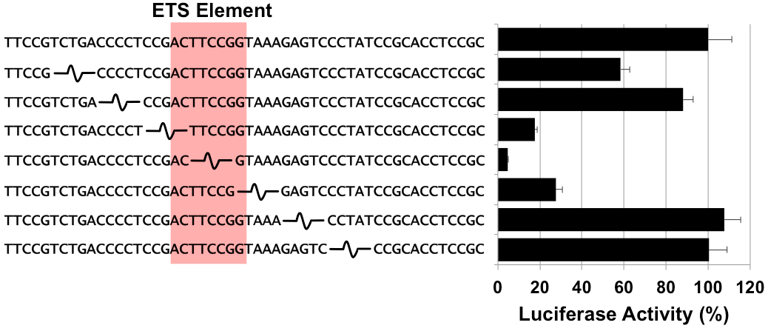
ATXN2 Promoter Analysis
X
Luciferase
ATXN2 promoter
Rat Prolactin Minimal Promoter Constructs
Notes:
exploited
----- Meeting Notes (2/1/16 16:22) -----
barbara graves

Slide 13
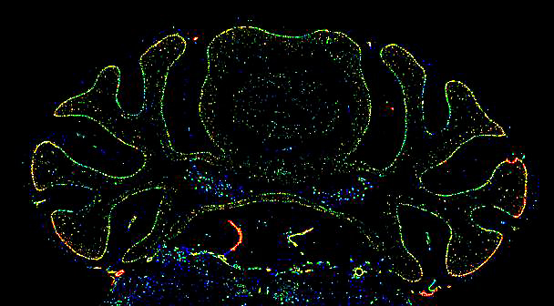
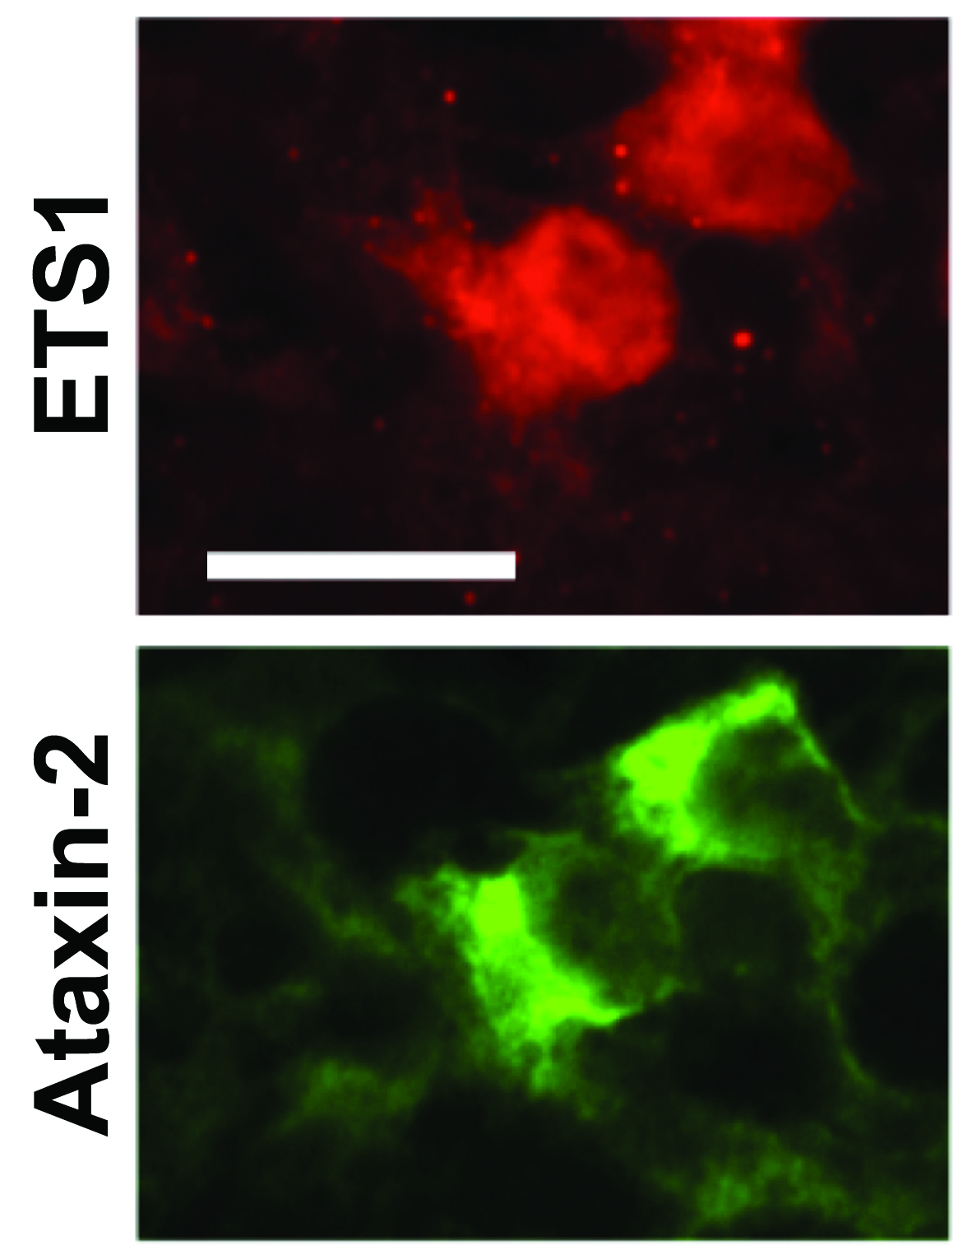
ETS1
ETS1 directly binds the ATXN2 promoter element
• EMSA supershift • ChIP-PCR assay
ETS1 expression determines ATXN2 expression
• ETS1 shRNA • ETS1 overexpression
Ets1 is expressed in cerebellar Purkinje cells
Transfection of ETS1
increased ATXN2 expression
Allen Brain Atlas
Gambogic acid inhibits Ets1 expression
Wang et al., Int. J. Nanomedicine, 2012:7 781–787
Scoles et al., 2012 Hum Mol Genet

Slide 14
Screening Assay
Primary Assays 5-6 doses
ATXN2-LUC & Viability Counterscreen
Secondary Assays 5-6 doses
NCGC
ATXN2-LUC & Viability Counterscreen
CMV-LUC & Viability Counterscreen
Luciferase enzymatic assay
Tertiary Assays
ATXN2-LUC & Viability Counterscreen
UTAH
CMV-LUC & Viability Counterscreen
Orthogonal Assay
Endogenous ATXN2 by Quantitative PCR

Slide 15
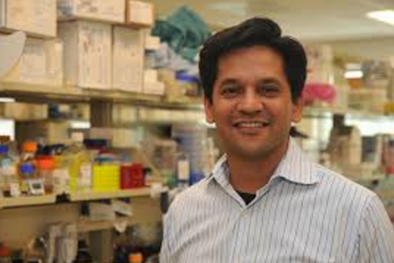
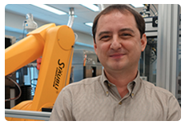
Robotic Compound Screening
Ajit Jadhav
NCGC Branch Chief
Anton Simeonov
NCATS Scientific Director
NCGC Co-founder

Slide 16
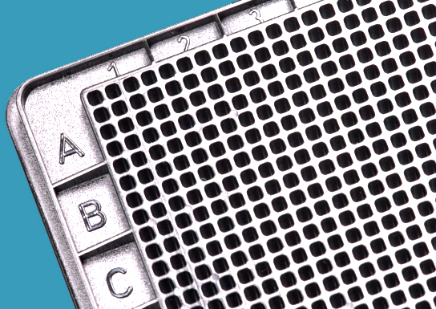
numbers
400,000 compounds @ 6 doses each
2.8 million wells needed
1536 well plate format
1,822 plates
1,822 plates needed & 11 liters of luciferase reagent

Slide 17
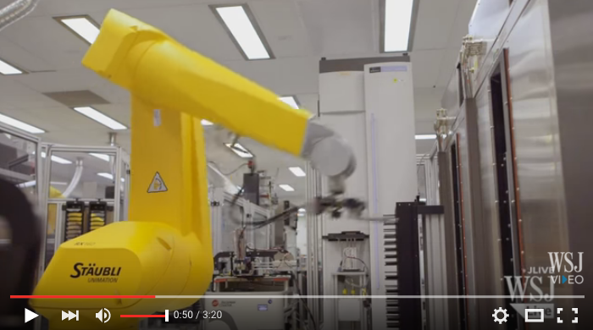
NIH Chemical Genomics Center
https://www.youtube.com/watch?v=ra0e97Wiqds

Slide 18
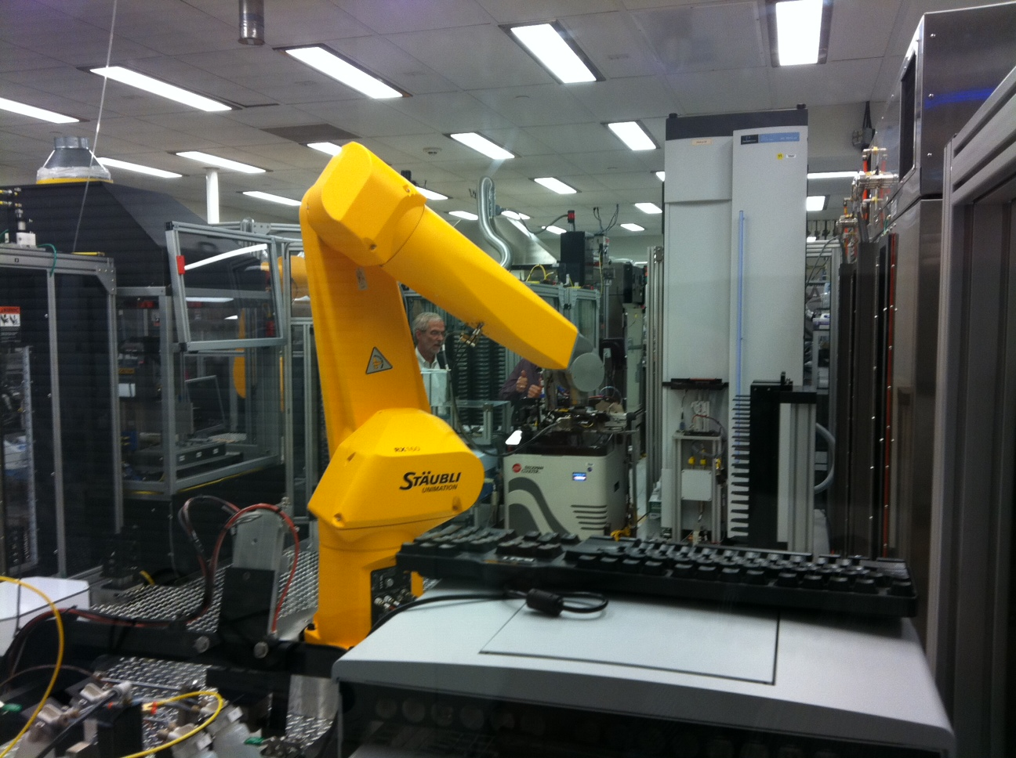

Slide 19
The ATXN2 screen
ATXN2-LUC
VIABILITY
ATXN2-LUC
VIABILITY
CMV-LUC
VIABILITY
FIREFLY LUC
359,840 screened
2763 passed
391,067
3772 cytotoxic
1439 Passed
757 Passed
416 Passed
608 Passed
1264 Passed
400,000
COMPOUNDS
TESTED IN PRIMARY ASSAYS
2145
COMPOUNDS
ADVANCED TO
SECONDARY ASSAYS
90 COMPOUNDS PROVIDED TO OUR LABORATORY
Cardiac Glycosides HSP90 Topoisomerases
30
11
8

Slide 20
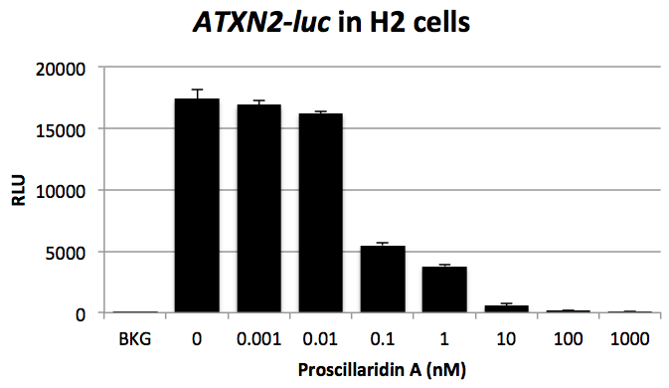
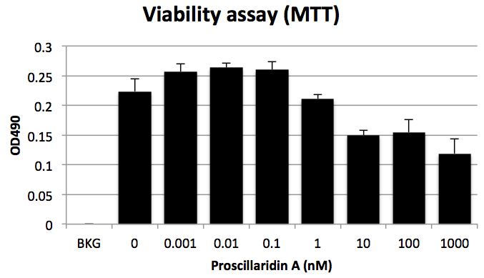
Proscillaridin A inhibits ATXN2-luc

Slide 21
SH-SY5Y cells treated with Proscillaridin A 48 hrs
Endogenous ATXN2 by qPCR

Slide 22
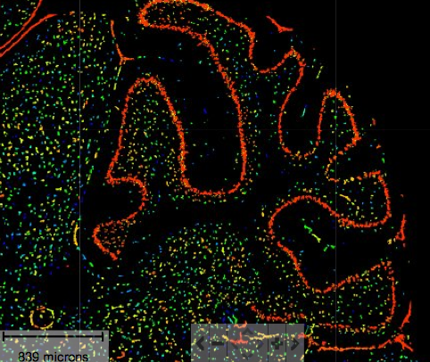
ATP1A2 overexpression increased ATXN2-luc expression
Atp1a2
Allen Brain Atlas
SH-SY5Y

Slide 23
Why is NaK-ATPase activity associated with ATXN2 expression?
Hypothesis: ATXN2 expression is associated with altered cytoplasmic calcium levels caused by altered ATP1A2 activity.
Identification of a specific role for the NaK-ATPase a2 isoform as a regulator of calcium in the heart (James et al., Mol Cell 3:555-563; 1999).
NaK-ATPase tethers phospholipase C and IP3R into a calcium-regulatory complex
(Yuan et al., Mol Biol Cell 16:4034-4045; 2005).

Slide 24
A Treatment for SCA2
COMPOUND SCREENING
TARGETING CALCIUM
STRESS GRANULES

Slide 25
Calcium Hypothesis of SCA2
Simultaneous monitoring firing in extracellular recordings
Parallel Fibers
Current Injection
mGlur1
inhibitors
WT
MT
Glutamate
mGlur1
Purkinje cell
dendrites
Gαq
PLCβ
Oregon Green
488 BAPTA
IP3
Rgs8
MUTANT
Ca²⁺
ATXN2
InsP₃R
With pharmacological blockage of AMPA receptors
Dansithong et al., 2015
Liu et al., 2009
Ca²⁺
ER

Slide 26
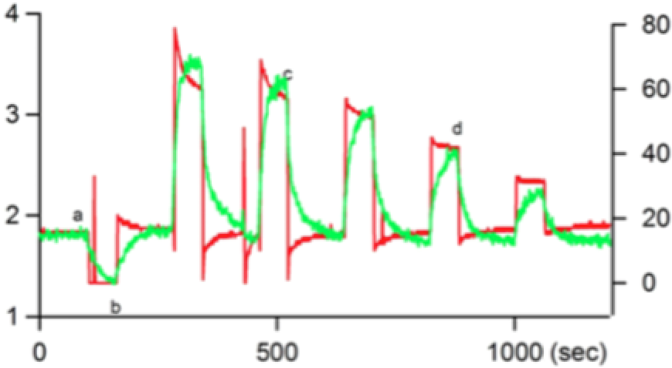
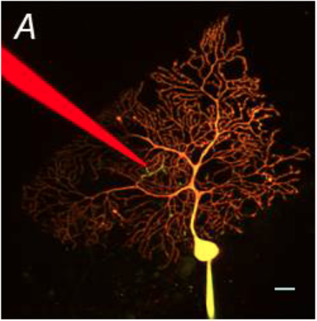
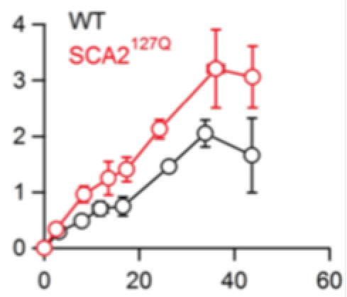
PC Calcium changes associate with firing freq.
Tom Otis & Pratap Meera
Fluoresence
Firing Freq (Hz)
Δ Fluoresence
Firing Freq (Hz)
Q127
WT

Slide 27
A Treatment for SCA2
COMPOUND SCREENING
TARGETING CALCIUM
STRESS GRANULES

Slide 28
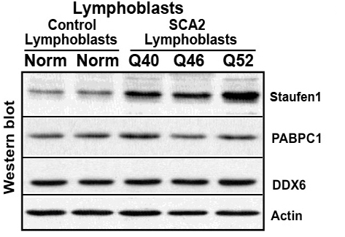
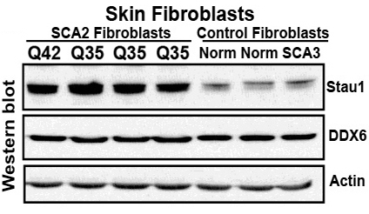
Staufen 1 interacts with Ataxin-2 by coIP
Staufen 1 is overexpressed in SCA2 patient cells
Sharan Paul

Slide 29
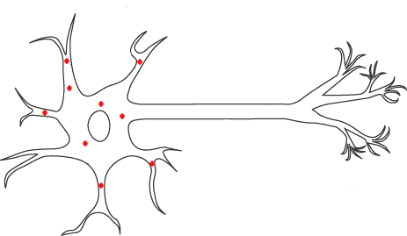
Staufen function
Staufen mediated mRNA decay
hairpin
STAU
UPF1
mRNA
Staufen
Mediated
Decay
UPF1
lncRNA
mRNA
STAU
Staufen directs sequestration of mRNA into stress granules
Staufen stress granules traffic mRNAs in dendrites
ATXN2 STAU1
SH-SY5Y cells, 15 min at 43.5 °C

Slide 30
Stress granules are constitutively present in SCA2[Q42] patient fibroblasts

Slide 31
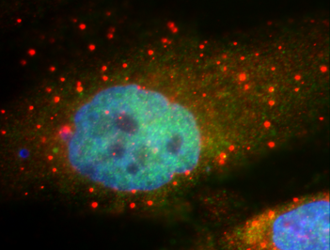

Slide 32
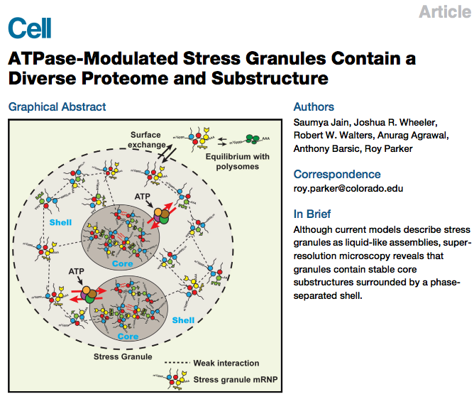
Jain et al., Cell 164:487-98
Jan 28 2016

Slide 33
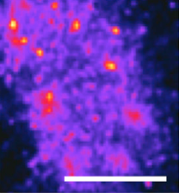
Isolation and Analysis of Stress Granules
Isolation of stress granules
Lysate
Differential centrifugation
Affinity Purification
Microscopy
Proteomics
qPCR
RNA-seq
Superresolution Microscopy (STORM)
2 μm
FISH using Oligo(dT) probe
Jain et al., 2016
Notes:
G3BP is a RAS GTPase that localizes to SGs
STORM = stochastic optical reconstruction microscopy

Slide 34
Stress Granule by 3D STORM
GFP-G3BP
PolyA mRNA
U2OS cells, bone osteosarcoma Jain et al., 2016

Slide 35
Ataxin 2 Stress Granules
ATXN2 Mutation
STAUFEN
Stress granule size and abundance
mRNA sequestration in SGs
Altered SG trafficking
Staufen Mediated mRNA Decay
?
Stau2 & RGS4:
Heraud-Farlow et al., Cell Reports 5:1511; 2013
RGS8
PCP2
Redd et al. J Neurosci Res. 2002 70:631-7.
Gαq
Gα0
CALCIUM MOVEMENT
Notes:
Staufen2 traffics RGS4
Pcp2 binds G-alpha-zero

Slide 36
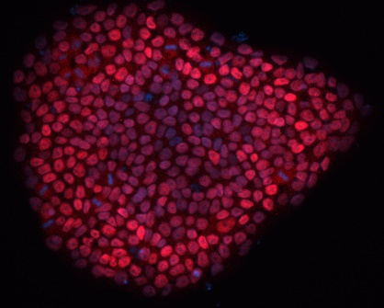
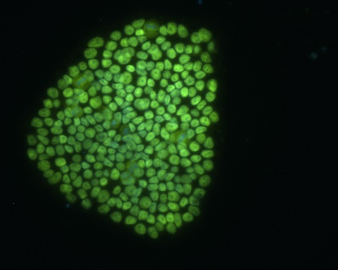
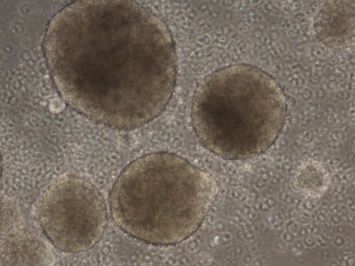
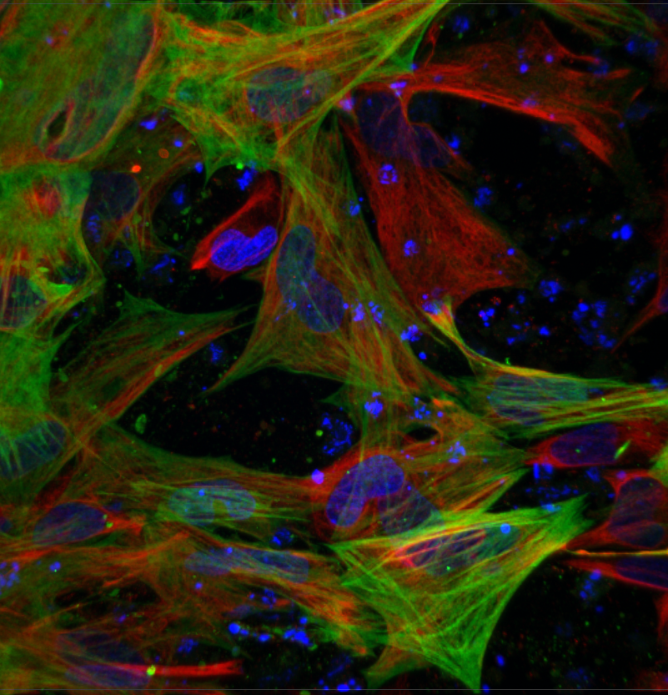
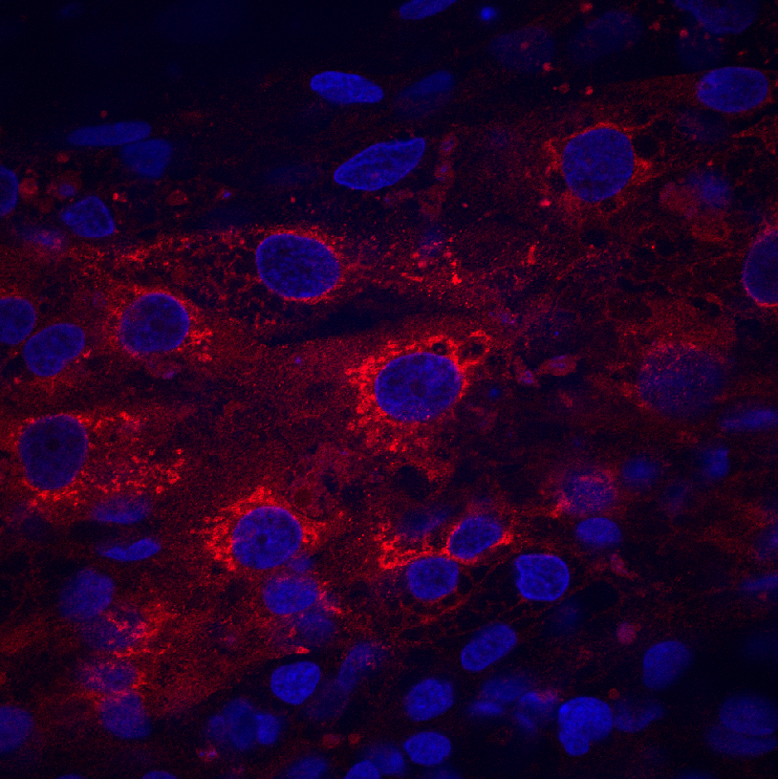
Production of SCA2 Embryoid Bodies
NANOG
OCT4
EBs
Ectoderm
Mesoderm
Endoderm
Nestin/SMA
AFP
Sharan Paul & Amber Staples

Slide 37
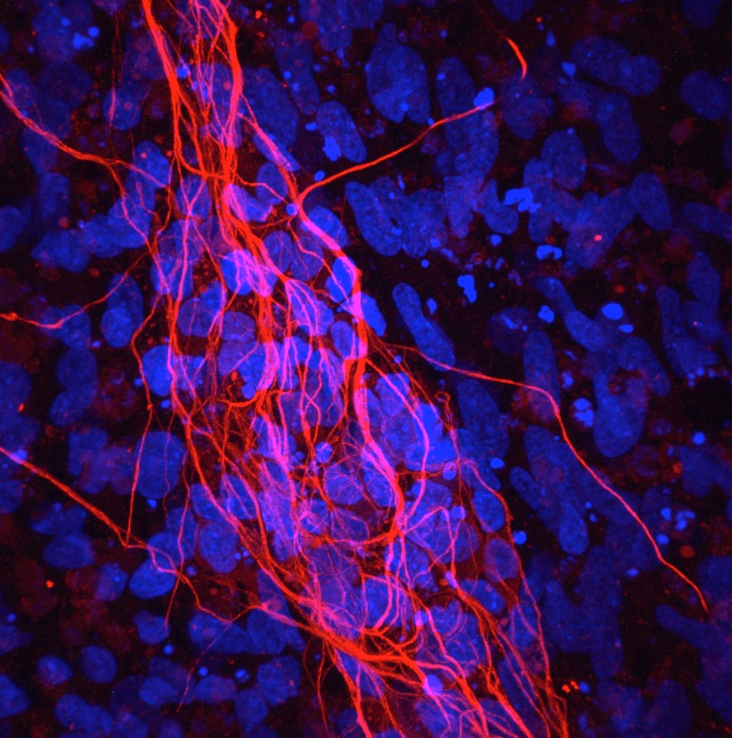
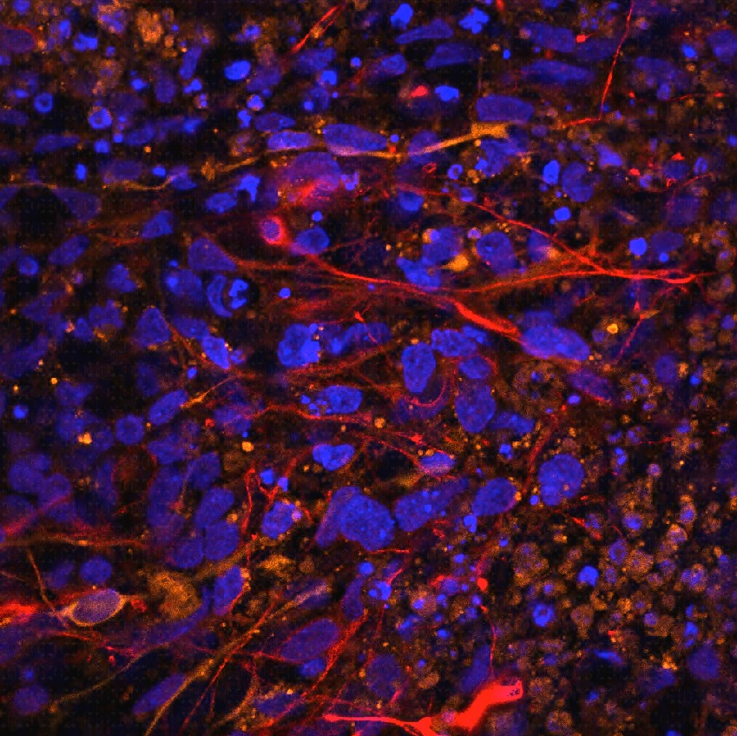
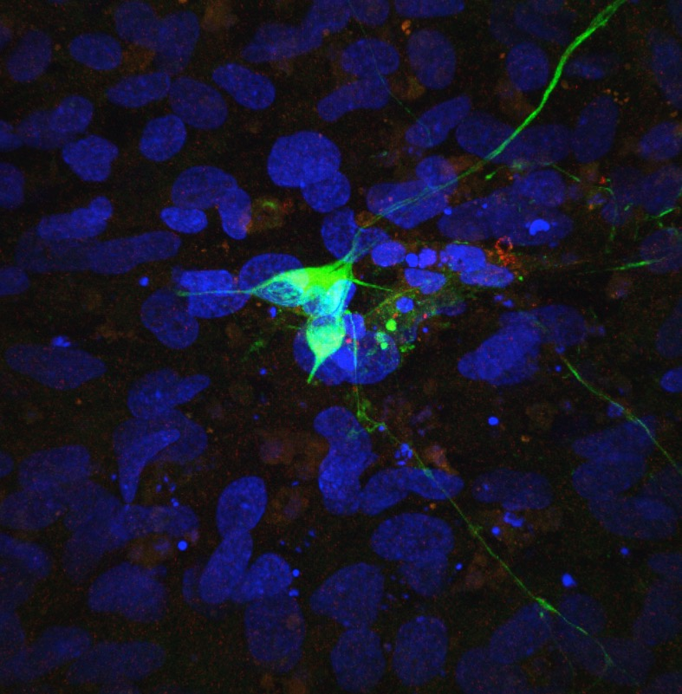
Production of SCA2 neurons
TUJ1
SMI-32
TH
Pan-neuronal
Motor Neurons
Dopaminergic
Sharan Paul & Amber Staples

Slide 38
Summary
Stress Granules
Staufen
Mediated
Decay
Identification of new
SCA2 therapeutics
Transcriptome Analysis
SCA2 mice
SCA2 x Staufen ko mice
SCA2 x mGlur1 ko mice
ATXN2 ASOs
ATXN2 inhibitors
mGlur1 inhibitors
New therapeutic targets
Calcium
Abundance
Validation of therapeutics
from completed screens
(compounds & ASOs)
SCA2 Fibroblasts
SCA2 Neurons
PC Morphology
Electrophysiology

Slide 39
Notes:
I’d like you to think that we are progressing toward a cure for SCA2

Slide 40
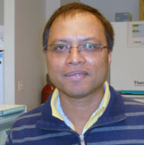
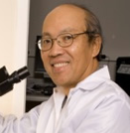
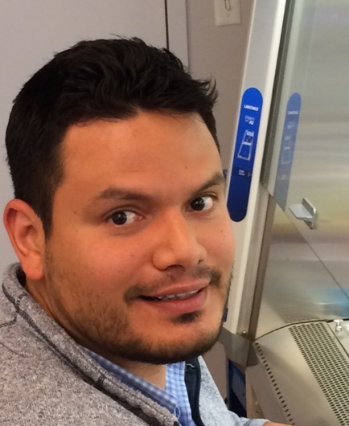
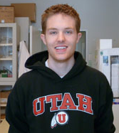
Acknowledgments
Me
Hayden
Sharan
Warunee
Duong
Linh
Chris
Cristhian
Lance
Matt
Pattie
Stefan Pulst
UROP
Amber Staples & Allison Harden
Gene Hung, Frank Rigo,
Paymaan Jafar-nejad
Frank Bennett
Tom Otis
Pratap Meera
Ajit Jadhav
Anton Simeonov
David Maloney
Julio Facelli
Lance Pflieger
Jingran Wen
David E. Jones
Biomedical
Informatics
Funded by NINDS grants RC4NS073009, R21NS081182, R37NS033123, & Ionis Pharmaceuticals

