Slide 1
Antisense oligonucleotides for the treatment of spinocerebellar ataxia type 2 (SCA2)
Daniel R. Scoles
Matt D. Schneider
Meera Pratap
Gene Hung
Frank Rigo
C. Frank Bennett
Thomas Otis
Stefan M. Pulst
Disclosures: ASOs were provided by Isis Pharmaceutics.

Slide 2
Spinocerebellar Ataxia Type 2 (SCA2)
SCA2 is a dominantly inherited polyglutamine disorder caused by ATXN2 mutation that causes ataxia.
Age of onset is characterized by anticipation where CAG22-23 is normal and CAG ≥ 33 causes disease.
Characterized by gain of toxic function & Purkinje cell death.
We hypothesize that lowering ATXN2 expression will be therapeutic for SCA2

Slide 3
MOE antisense oligonucleotide (ASO) structure and action
MOE Gapmer
MOE
PS
MOE
152 ASOs screened in vitro for lowering ATXN2 expression
5 bp 10 bp 5 bp
ASOs stimulate RNase H
15 LEADS
100
Plate 1
mRNA
80
% of UTC
60
ASO
40
20
0
ASOs
UTC
RNase H
Plate 2
100
80
% of UTC
Cleaved mRNA
60
40
20
Intact ASO
0
ASOs
UTC
4.5 μM ASO in HepG2 cells
Notes:
Here is the structure of the ASOs we are using and how they work.
These ASOs are the MOE gapmer variety
They have modified nucleotides, including the O-methoxyethyl modification at the 2’ position, and a phosphorothioate backbone.
The MOE modification enhances ASO stability and inclusion of a 10 bp gap of regular phosphorothioate ensures RNase H destruction of target mRNAs

Slide 4
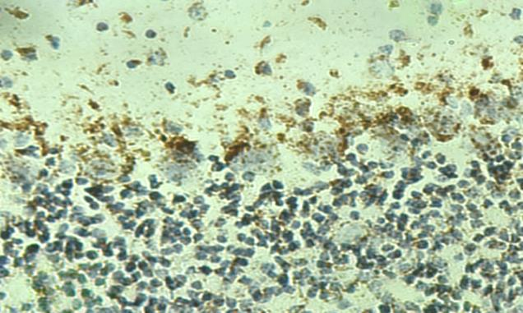
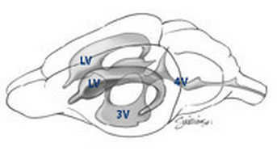
In vivo tests using Pcp2-ATXN2-Q127 mice
Injected ASOs accumulated in Purkinje cell layers
Intracerebroventricular (ICV) Injection
Molecular layer
Purkinje cell layer
Anti-ASO
Granule layer
Cerebellar ATXN2 and IbaI by qPCR after 7 days treatment with 250 μg ASO
JAX
Right Lateral Ventricle
% ATXN2 / Actin
% Iba1 / Actin
Microgliosis
Sal 1 3 7 8
Sal 1 3 7 8
ASO
ASO

Slide 5
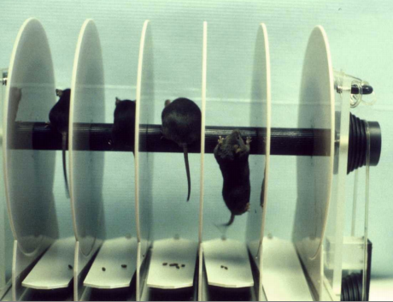
ASOs reduced rotarod phenotype onset in
Pcp2-ATXN2-Q127 mice
ICV@8wks
ICV@8wks
ICV@14wks
ATXN2-Q127
Rotarod Phenotype
* * **
← ASO-7 vs SAL
P=0.11^{NS}
P=0.04*
* *** ** ***
N
13
N
15
WT
15
ASO7
27
SALINE
23
Means ± SEM
200 μg ASO
Means ± SEM
210 μg ASO
TG
week 13 week 17 week 21
4 8 12 24 36
week 13 week 19
Weeks
Endpoint cerebellar human ATXN2 expression by qPCR
Hansen et al., 2012
** **
**

Slide 6
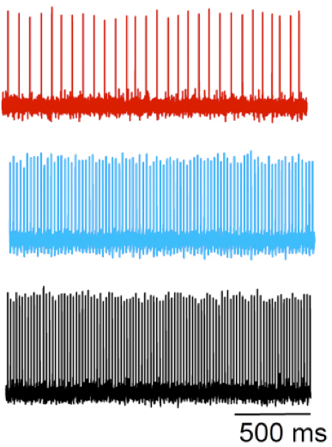
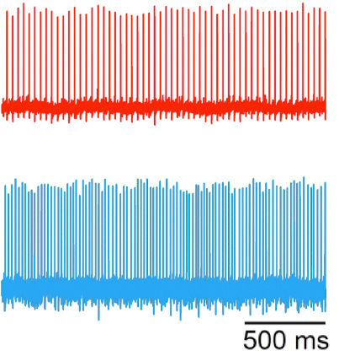
ASO7 restored the Purkinje cell firing frequency of Q127 mice
Extracellular Recordings – Meera Pratap & Tom Otis
N (# neurons)
Hansen et al., 2012
43-120
54-79
21 wk old mice treated 13 wks
13 wk old mice treated 5 wks
Saline
16±1 Hz
N=107 neurons
Saline
25±1 Hz
N=50 neurons
ASO7
42±2 Hz
N=102 neurons
46±2 Hz
N=88 neurons
ASO7
40±1 Hz
N=50 neurons
WT

Slide 7
Conclusions and the Future
CONCLUSIONS
ATXN2 ASOs
have a prolonged effect,
Delay onset of SCA2 mouse phenotypes.
FUTURE WORK
Modification of ASO chemistry.
For maximum efficacy with minimum toxicity.
Optimization of ASO dose and treatment times.
Additional animal models (FLAG-ATXN2-Q129).
ASO reduction of ATXN2 in spinal cord motor neurons
RNA-seq analysis for evaluating off-target effects.

Slide 8
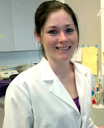
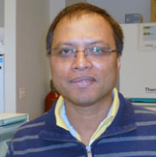
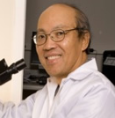
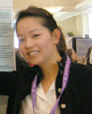
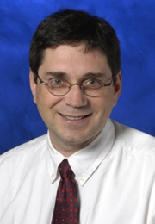
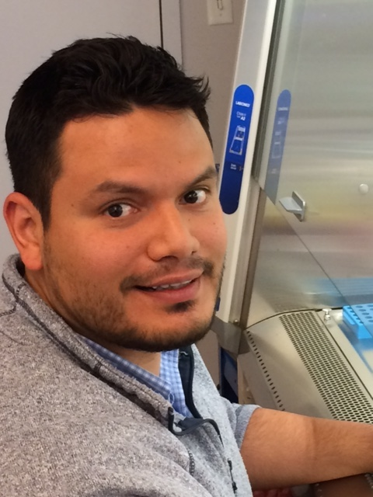
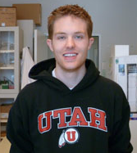
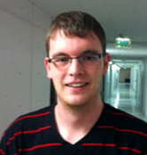
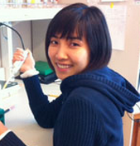
Acknowledgments
Meera Pratap & Tom Otis
Gene Hung, Frank Rigo & Frank Bennett
Funded by NINDS grants R21NS081182, R01NS033123, R37NS033123, R56NS033123

