Slide 1
MOE antisense oligonucleotides for the treatment of spinocerebellar ataxia type 2 (SCA2)
Daniel R. Scoles
Matt D. Schneider
Brandon Henrie
Meera Pratap
Gene Hung
Frank Rigo
Thomas Otis
C. Frank Bennett
Stefan M. Pulst
Disclosures: ASOs were provided by Isis Pharmaceutics.
Notes:
I would like to thank the SfN organizers for allowing me to present my data to you today.

Slide 2
Spinocerebellar Ataxia Type 2 (SCA2)
SCA2 is a dominantly inherited polyglutamine disorder caused by ATXN2 mutation.
Gait ataxia, frontal executive dysfunction, slow saccades, and parkinsonism.
Age of onset is characterized by anticipation where CAG22-23 is normal and CAG ≥ 33 causes disease.
Characterized by Purkinje cell death.
Gain of toxic function.
Notes:
One of the principal objectives of our laboratory is the identification of treatments for spinocerebellar ataxia type 2 (SCA2). Presently there are no treatments for this disease.
SCA2 is a dominantly inherited polyglutamine disorder that is caused by CAG expansion mutation in the ATXN2 gene.
Patients are characterized by gait ataxia, frontal executive dysfunction, slow saccades, and rarely mutation of the ATXN2 gene is associated with DOPA-responsive parkinsonism.
A-of-O is characterized by anticipation where CAG lengths of 22-23 are normal and >32 is disease causing, and the longer the repeat length the greater the severity.
SCA2 is also characterized by PC death, and gain of toxic function.

Slide 3
Hypothesis
Reducing ataxin-2 expression may be therapeutic for SCA2.
SCA2 phenotype is worse in patients homozygous for the disease allele (Ragothaman and Muthane, 2008).
SCA2 phenotype is worse in homozygous vs heterozygous ATXN2 transgenic mice (Huynh et al., 2000).
Reversibility of SCA1&3 transgenic mouse phenotype (Zu et al., 2004; Boy et al., 2009).
Injection of AAV expressing ATXN1-targeted miRNA improved SCA1 mouse phenotype (Keiser et al., 2014).
ASOs improve HD mouse phenotypes (Østergaard et al., 2013; Carroll et al., 2011).
Notes:
Because SCA2 is dominantly inherited, and characterized by gain of function, and because a definitive cellular pathway mediating mutant ataxin-2 function related to SCA2 onset is not known, we are pursuing a strategy to lower ATXN2 expression in effort to identify SCA2 therapeutics.
Our hypothesis is supported by several observations indicating SCA2 phenotype severity is dose dependent.
Patients with 2 disease alleles had more severe phenotype.
The same was observed for homozygous vs heterozygous ATXN2 transgenic mice.
Inducible mouse models showed that SCA1 and SCA3 mouse phenotypes were reversible.
And there are other proof-of-principle studies: Targeting ATXN1 with miRNAs improved SCA1 mouse motor phenotype, and antisense oligonucleotides improved HD mouse phenotypes as well.
Isis also has clinical trials for testing ASOs for treating SMA and ALS with promising outcome data.
The antisense oligonucleotide strategy that we are taking will also target the normal ATXN2 allele, and we believe this will be tolerated because knockout mice developed obesity but were otherwise normal.

Slide 4
MOE antisense oligonucleotide (ASO) structure and action
“MOE Gapmer”
MOE
PS
ASOs stimulate RNase H
MOE
5 bp 10 bp 5 bp
2’-O-methoxyethyl (MOE)
mRNA
ASO
O
BASE
RNase H
OCH
Cleaved mRNA
O
O
3
O
PS
P
Intact ASO
-
2’-MOE
S
O
Notes:
Here is the structure of the ASOs we are using and how they work.
These ASOs are the MOE gapmer variety
They have modified nucleotides, including the O-methoxyethyl modification at the 2’ position, and a phosphorothioate backbone.
The MOE modification enhances ASO stability and inclusion of a 10 bp gap of regular phosphorothioate ensures RNase H destruction of target mRNAs

Slide 5
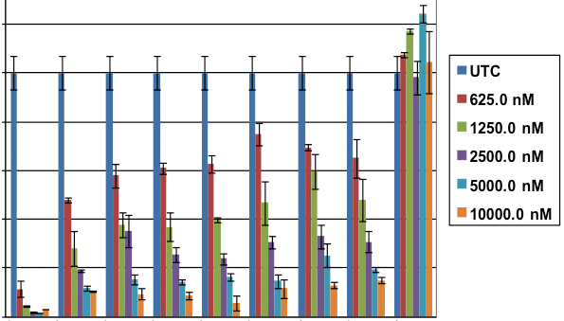
A cell-based screen identifies potent ASOs against mouse & human ATXN2
8 Top Lead ASOs
152 ASOs screened
120
100
15 LEADS
% of UTC
80
100
Plate 1
80
60
% of UTC
60
40
40
20
0
ASOs
UTC
20
Plate 2
0
100
neg.
cont.
80
ASO# 1 2 3 4 5 6 7 8
% of UTC
60
40
IC50 (μM) 0.5 0.6 0.8 0.8 0.9 1.3 0.6 1.3
20
0
ASOs
UTC
4.5 μM ASO
HepG2 cells
In collaboration with ISIS Pharmaceuticals, Carlsbad CA
Notes:
In collaboration with ISIS Pharmaceuticals, we screened 152 ASOs designed to specifically target human ATXN2.
Next we did dosewise tests to determine IC50s for the top 15 lead ASOs. 8 of the leads were advanced to the next level of testing.

Slide 6
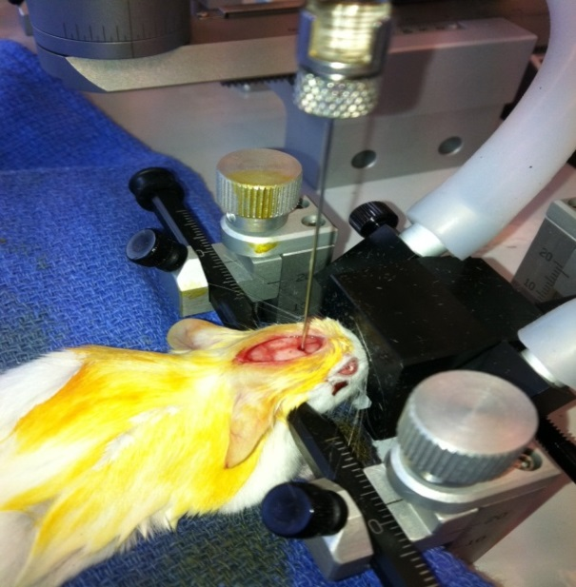
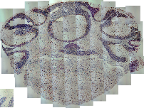
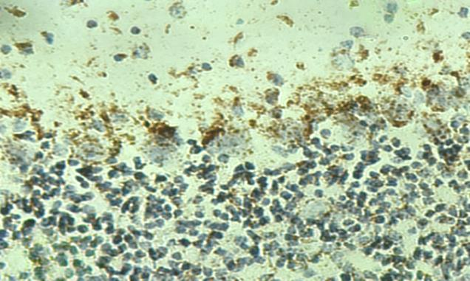
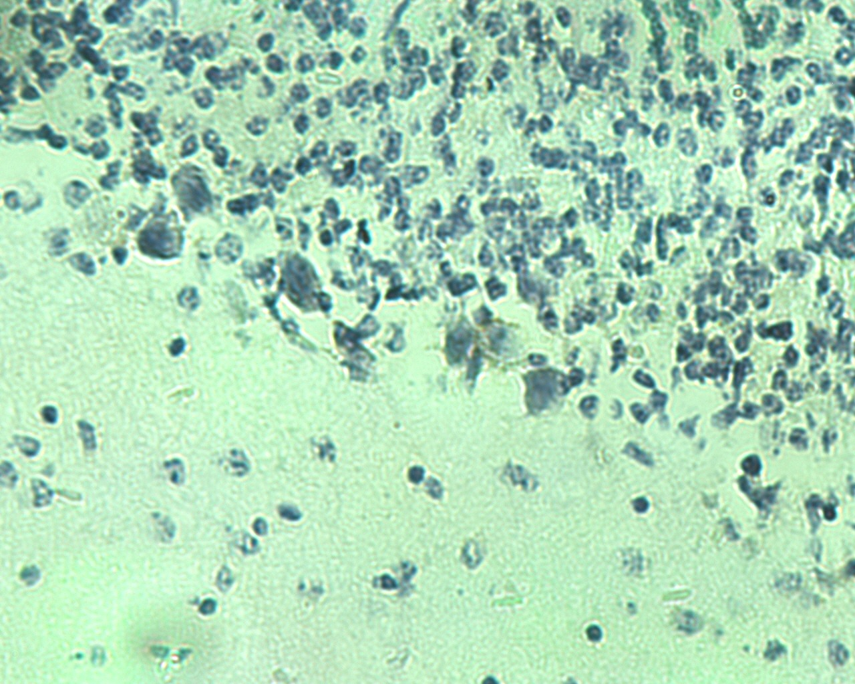
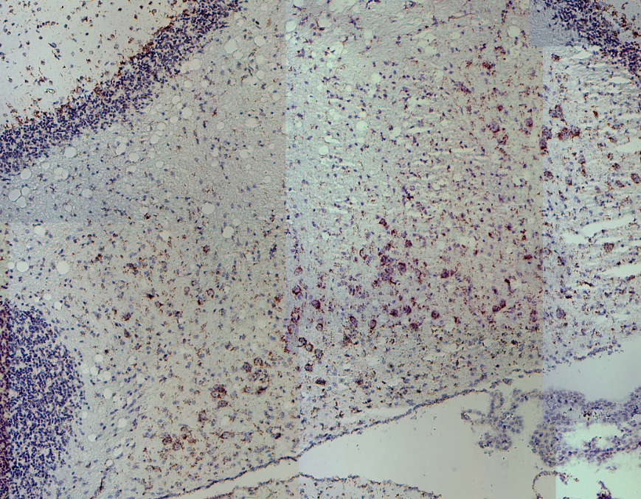
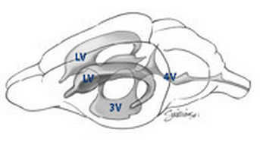
ASOs are taken up by PCs & deep cerebellar neurons
Intracerebroventricular (ICV) Injection
Staining with anti-ASO antibody
Coronal Section of Cerebellum
Purkinje cell layer
ASO injected
Deep Cerebellar Nuclei
JAX
Saline injected
Right Lateral Ventricle
Notes:
ASOs were delivered into the right lateral ventricle of our various SCA2 mouse models by intracerebroventricular injection. This was done using an isoflurane gas anesthesia system.
ASOs do not enter all cell types with the same efficiency, therefore we evaluated ASOs in injected brains for localization in Purkinje cells and deep cerebellar nuclei, using a specialized anti-ASO antibody developed by Isis Pharmaceuticals.
The result showed that the ASOs enter cells relevant to SCA2

Slide 7
Selected lead ASOs tested for lowering ATXN2 expression in SCA2 mice
hATXN2
mAtxn2
250 μg ASO
7d, qPCR,
n=2-3,
mean±SD.
BAC
SCA2-Q22
(FVB)
Sal 1 2 3 4 6
Sal 1 2 3 4 6
% ATXN2 Expression
ASO
ASO
Pcp2-
ATXN2-Q127
(B6/D2)
(Hansen et al., 2013)
Sal 1 3 7 8
Sal 1 3 7 8
ASO
ASO
Notes:
We evaluated the leads for target knockdown in vivo in multiple types of mice.
Our BAC mice possess the entire 176 kb ATXN2 gene region, including 16 kb upstream sequence and 2.5 kb downstream sequence. We also have a Q72 version in which ASOs work similarly. Notice that the pattern of human or mouse ATXN2 reduction was similar for the different ASOs tested.
We also evaluated selected leads in ATXN2-Q127 transgenic mice, that have ATXN2 expressed under the control of the Purkinje cell specific promoter PCP2. These mice have well defined SCA2 neurophysiological, molecular, and motor phenotypes. Again lead ASOs had similar effects on both human and mouse ATXN2.
The rest of the presentation will focus on ASO leads 1, 3 and 7, and all in vivo work from this point forward utilized ATXN2-Q127 transgenic mice.

Slide 8
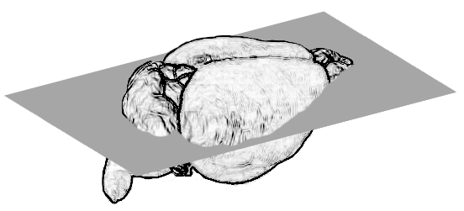
The three best lead ASOs did not significantly elevate the microgliosis marker Iba1 in ATXN2-Q127 mice
Microgliosis
Iba1 Staining
Saline
ASO1
ASO8
% Iba1 / Actin
200 μg
Injection site
qPCR
N=2-11
7 days
mean±SD
Axial
Notes:
So far our evaluation of toxicity included qPCR and immunohistochemical staining for the microgliosis marker Iba1, and staining for GFAP as well but I did not include any GFAP data in the presentation. ASO8 consistently elevates Iba1 expression, serving as a positive control for toxicity. The other ASO leads were not significantly different than for saline injection, although saline alone does elevate Iba1 at the site of injection. Staining for Iba1 in ASO8 injected mice indicated a wider spread of reactive microglia.
We observed no evidence of toxicity for ASOs 1 3 and 7.

Slide 9
ASOs reduce ATXN2 expression in ATXN2-Q127 mice
Time course study
ICV 200 μg ASO-1
Dosing study:
ICV injection of increasing doses
of ASO-1, treated 7 days.
qPCR
N=3-7
ATXN2
Actin
DAYS
Western blot
Saline ASO1
ATXN2
μg ASO-1
Actin
Notes:
Next we wanted to understand dose and timing of effects.
Here I’m only showing you data for ASO-1. For 7 days treatment time, we saw the best reduction of ATXN2 expression for 200 ug ASO. Mouse ATXN2 was always a little bit higher. Therefore we utilized 200 ug for our long term experiments.
A timecourse study showed that human ATXN2 was maximally reduced after 18 days but atxn2 stayed 65% reduced after 84 days treatment time.
The ASO effects could also be easily seen by western blotting.

Slide 10
ASO effects on SCA2 molecular phenotypes
Expression in Cerebellar Extracts
hATXN2
ATXN2-Q127 or WT
200 μg ASO-1
12 weeks treatment
N=7
**
**
*
ns
Expression relative to actin
*
ns
Dansithong et al., submitted
Notes:
We then went on to evaluate the lead ASOs for modifying SCA2 phenotypes in ATXN2 Q127 mice.
In the first experiment using ASO1, after 12 weeks we found significant reduction of human ATXN2, and reduced mouse ATXN2.
The first molecular markers that we evaluated are those we have long used standardly as indicators of Purkinje cell health, the Purkinje cell specific genes PCP2 and Calb1, which are lowered in expression as the SCA2 phenotype onsets. This trend is reversed in ASO treated mice.
We have also done RNA-seq analysis of ATXN2-Q127 mice of various ages. The genes Rgs8 and Fam107b emerged from those studies as the genes with the greatest reduction as SCA2 onsets. Again we see that this trend is reversed in ASO treated mice.

Slide 11
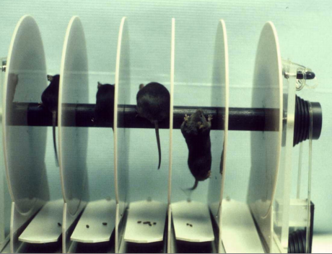
ASO effects on SCA2 motor phenotypes
Accelerating rotarod
Rotarod Paradigm
Handling day –3 minutes
Rod into day– 0-10 RPM
Test Day 1 – 0-40 RPM over 6 min
Test Day 2 – 0-40 RPM over 6 min
Test Day 3 – 0-40 RPM over 6 min
We report the mean latency to fall for trial 3 of each day.
Each step done in 3 trials.
Eight week old Pcp2-ATXN2-Q127 mice treated with 200 μg ASO.
Testing at 5, 9, and 13 weeks.

Slide 12
Rotarod testing of Pcp2-ATXN2-Q127 mice treated with 200 mg ASOs
<0.05 <0.05 <0.01
← ASO7 vs SAL
N
13
15
15
After 13 weeks treatment ATXN2 expression remained low
qPCR
Notes:
The motor phenotype data that we currently have is for ASOs 3 and 7. This data was collected using the accelerating rotarod, recording daily mean latency to fall over a 3 day period. After 5 weeks post ICV treatment, saline treated mice had a reduced performance vs ASO treated mice. After a total of 9 weeks the saline treated mice had an even further reduction in latency to fall. ASO7 treated mice had approximately the same performance as for 5 weeks, while the ASO3 treated mice were intermediate.
Analysis of variance showed a probability of 0.07, so we have not yet reached significance but the trend is in the right direction and these mice are still alive and will be retested.
“ASO7 halts the further deterioration of the motor phenotype”

Slide 13
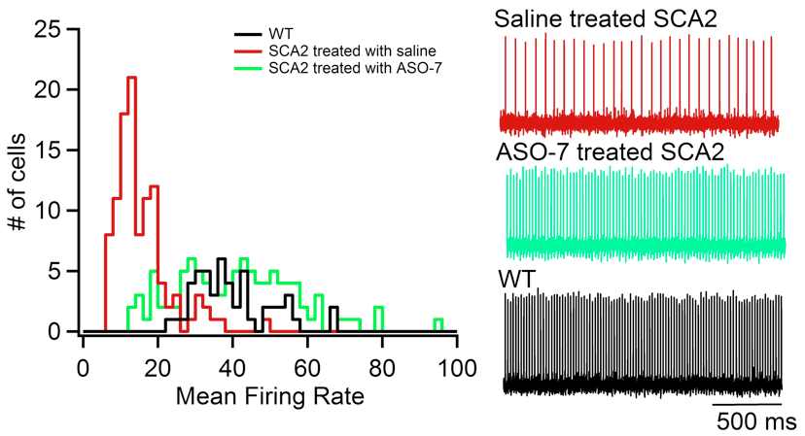
Neurophysiological phenotype of Q127 mice treated with ASO-7 13 weeks
Tom Otis & Meera Pratap, UCLA
Q127 mice have age-dependent abnormally slow Purkinje cell firing frequency (Hansen et al., 2013).
mice
Mice Neurons Mean
2 107 16±1 Hz
mice
2 102 42±2 Hz
mice
1 50 40±1 Hz
Extracellular slice culture recordings

Slide 14
Conclusions and Future Directions
Conclusions
ASOs lowered ATXN2 expression with prolonged effect.
ATXN2 ASOs improved expression of molecular markers of Purkinje cell health.
ATXN2 ASOs modified the rotarod and neurophysiological phenotypes of SCA2 transgenic mice.
Future Directions
Different ASO doses, ASO treatment times, & multiple ASO treatments.
Modifying ASO chemistry.
Additional animal models.
BAC SCA2 [Q72] mice
ATXN2 promoter [Q129] transgenic mice
RNA-seq analysis for evaluating off-target effects

Slide 15
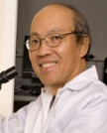
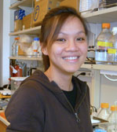
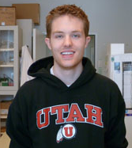
Acknowledgments
Thanks to our partners at Isis Pharmaceuticals
Our research team at the University of Utah
Thanks to Tom Otis and Meera Pratap
Funded by NINDS grants R21NS081182, RC4NS073009 & R01NS033123

