Slide 1
Developing Therapeutics for Polyglutamine Diseases
Daniel R. Scoles, Ph.D.
Research Associate Professor
Department of Neurology

Slide 2
Overview
Mutations and PolyQ diseases
Spinocerebellar ataxia type 2 (SCA2)
Drug Screening
Nucleic Acid-based therapeutic
Huntington’s Disease
Notes:
The organization of this talk has had may iterations. I tried to make the final version the most bare bones of all of them.
What I will do right at the is start provide you with the format of the pilot compound screen that I conducted and larger screen that we are doing at the NIH Chemical Genomics Center (the NCGC). This will serve as a sort of kernel of information on how compound screening is conducted for those who are unfamiliar.
We will then build on this with discussions on screen design depending on the mechanism of disease, and on different readouts.
Finally we will discuss what is needed to enter the MLPCN (molecular libraries probe centers network). We did gain entrance into the MLPCN so this is something that I do have some knowledge on that may be useful to others here seeking the same.
There will be deficiencies. While this talk is intended to be fairly comprehensive there are some methods I am not familiar with that will be discussed very briefly or not at all… for example high throughput flow cytometry. I try to at least make reference to such techniques so that it might help others think about their own applications of HT screening.
Overall this discussion is from the point of view of targeting a disease gene, with relevance to movement disorders, and making particular reference to polyglutamine disorders. There are many ways to conduct compound screening for multiple purposes that because of the disease gene focus may not be mentioned.

Slide 3
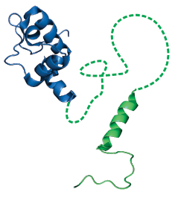
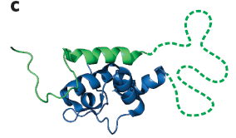
Mutations
X
Gene

Slide 4
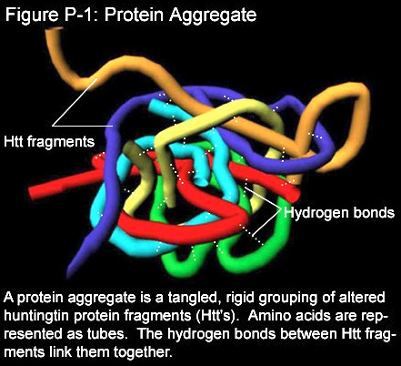
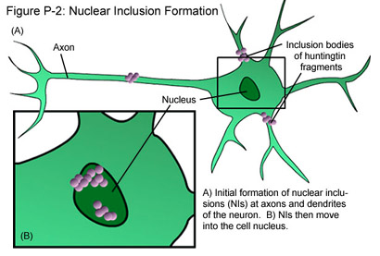
Polyglutamine Disease Mutations
Unstable CAG repeat expansion
CAG CAG CAG CAG CAG
Images from Stanford’s HD Outreach Project website

Slide 5
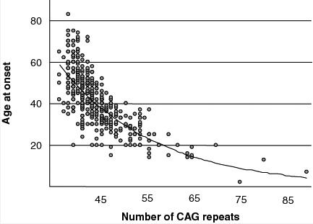
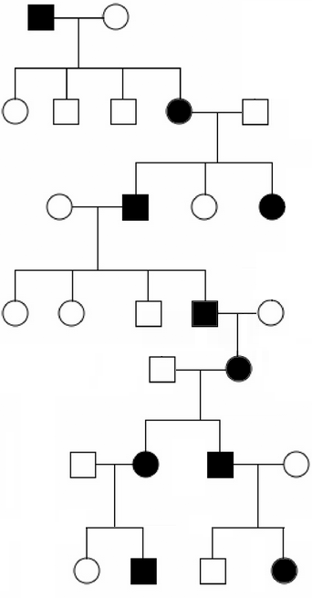
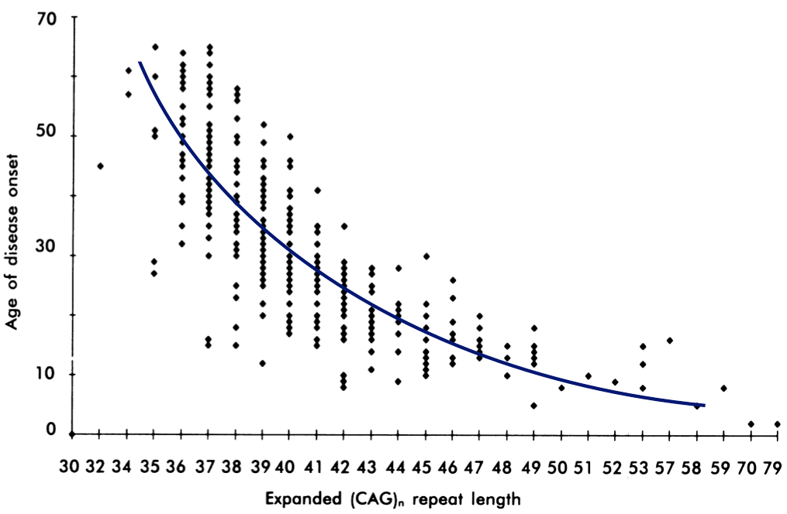
Anticipation
Huntington’s Disease
CAG35
CAG>36 causes HD
Age of Onset
CAG Length
SCA2
Age of Onset
CAG>32 causes SCA2
CAG48
CAG Length

Slide 6
Polyglutamine Diseases
Disease | Protein | Normal | Expanded | Clinical Features
HD | Huntingtin | 6-34 | 36-121 | Chorea, dystonia, cognitive decline, psychiatric impairment
SCA1 | Ataxin-1 | 6-44 | 39-82 | Ataxia, slurred speech, spasticity, cognitive decline
SCA2 | Ataxin-2 | 15-24 | 32-200 | Ataxia, neuropathy, decreased reflexes, infantile variant with retinopathy
SCA3 | Ataxin-3 | 13-36 | 61-84 | Ataxia, parkinsonism, spasticity
SCA6 | CACNA1A | 4-19 | 10-33 | Ataxia, dysarthria, nystagmus, tremors
SCA7 | Ataxin-7 | 4-35 | 37-306 | Ataxia, blindness, cardiac failure in infantile form
SCA17 | TBP | 25-42 | 47-63 | Ataxia, cognitive decline, seizures, psychiatric impairment
SBMA | Androgen Receptor | 9-36 | 38-62 | Motor weakness, swallowing, gynecomastia, decreased fertiility
DRPLA | Atrophin | 7-34 | 49-88 | Ataxia, seizures, choreoathetosis, dementia
Notes:
When you study one there are things that you can do to advance the development of treatments for others…and that is why I am here presenting my data on the development of SCA2 therapeutics at a forum on HD.
The genes have multiple functions, and for all of them we do not understand which functions are associated with pathogenesis… One thing these all have in common is a net gain of normal function. Therefore we have a hypothesis that lowering the disease gene expression may be therapeutic.

Slide 7
Huntington’s Disease vs SCA2
CAG
HD
SCA2
Unknown Protein Function
GOF, partial LOF
Striatum
Multiple Neurons
Cerebellum
Purkinje Neurons
Nuclear protein aggregates
Cytoplasmic protein aggregates
Chorea, anxiety, sleep disorder, rigidity.
Ataxia, slow saccades.
1 per 10,000
2-3 per 1,000,000
Common in Cuba

Slide 8
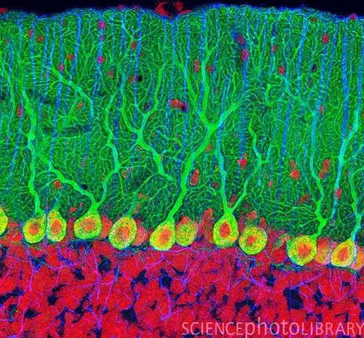
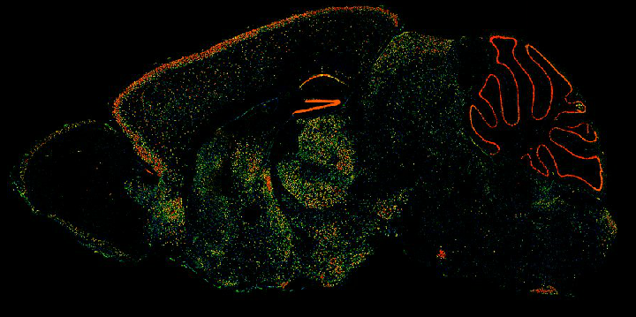
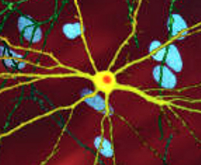
The Purkinje Neuron
Striatal Neuron

Slide 9
Therapies for Spinocerebellar Ataxia type 2 (SCA2)

Slide 10
Hypothesis
Lowering of the disease gene expression may be therapeutic for HD and SCA2
Gene dose relationship: SCA2 phenotypes are worse in patients or mice with two copies of the gene.
Disease reversibility in mouse models.
Notes:
Because a definitive cellular pathway mediating mutant ataxin-2 function related to SCA2 onset is not known, we are pursuing a strategy to downregulate ATXN2 expression or ATXN2 mRNA stability.
In so doing we are characterizing the expression control regions of the ATXN2 gene.
This approach is supported by several observations providing the study rationale: Gene dosage is important in SCA2 as patients homozygous for the mutation show a more severe phenotype. This also supported by experiments in transgenic mice as doubling of transgene dosage results in significantly earlier onset of SCA2 mouse disease phenotype.
Knockout of ATXN2 in mice on the other hand does not result in major CNS dysfunction, but causes obesity, a potentially beneficial side-effect as SCA2 patients are very often underweight.
Additionally, downregulation of mutant SCA1 or SCA3 alleles in rodents even after disease onset resulted in reversal of the phenotype.
In one study an shRNA was used to target total ATXN1 expression resulting in improved phenotype.

Slide 11
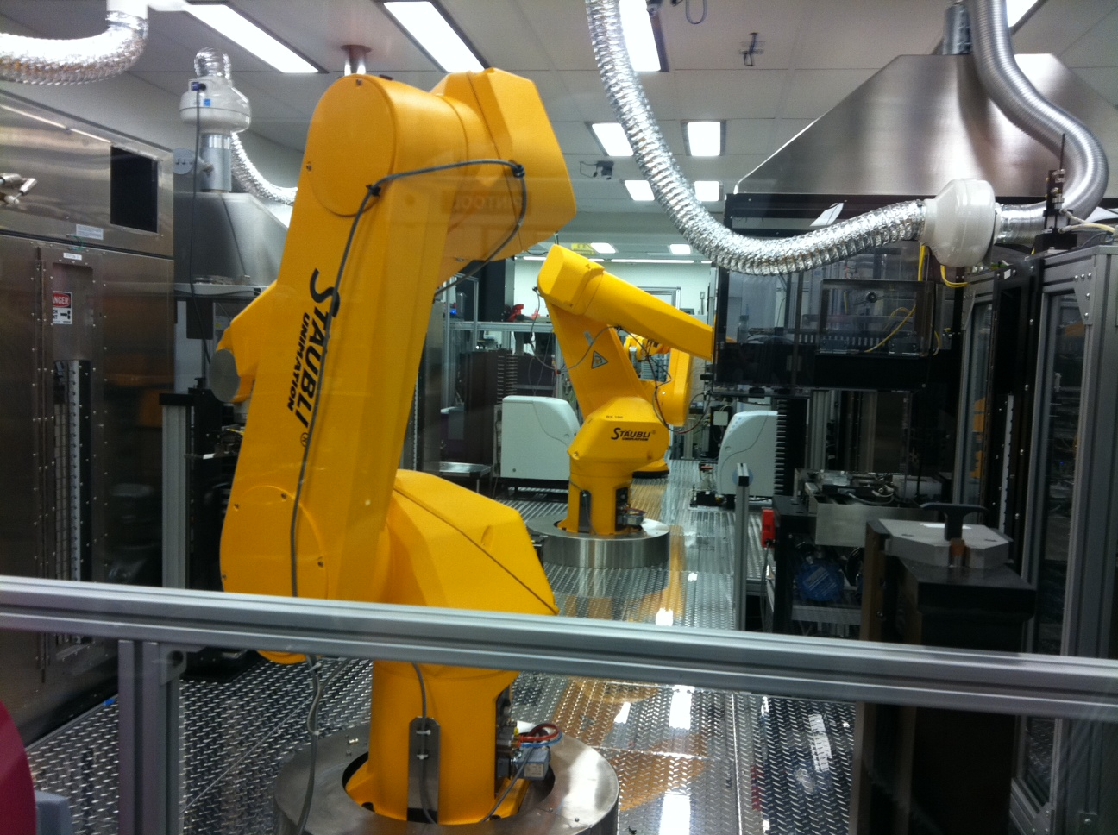
Robotic Drug Screening in the
NIH Chemical Genomics Laboratory (NCGC)
Notes:
Anticipation – genotype phenotype correlation with generation component
ATXN2 vulnerabilities

Slide 12
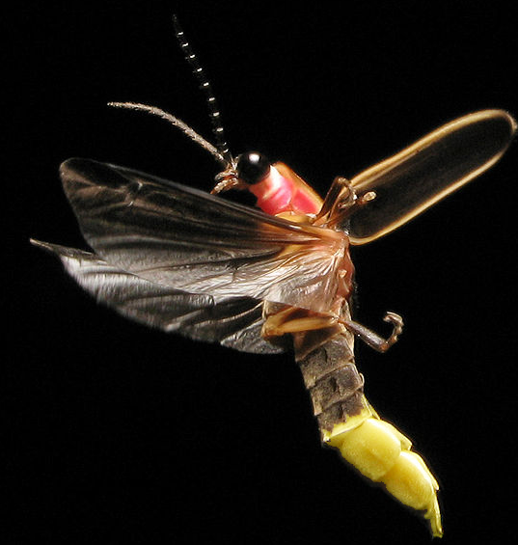
Looking for compounds that lower ATXN2-luciferase expression.
ATXN2 is the gene that is mutated in SCA2
Screening Strategy
450,000 compounds tested at 7 doses, robotically.
3.15 MILLION WELLS
ATXN2-end
luc
Light
X
ATXN2-beginning
Firefly
Notes:
Anticipation – genotype phenotype correlation with generation component
ATXN2 vulnerabilities

Slide 13
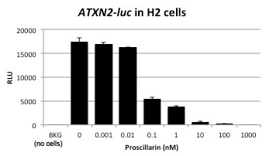
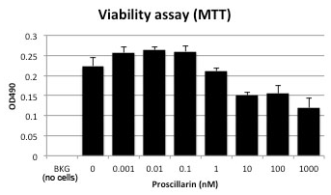
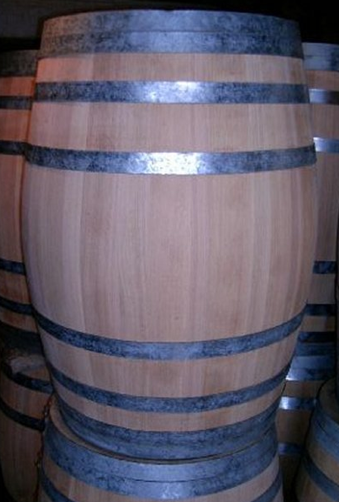
Proscillaridin A (Sodium Potassium ATPase inhibitor)
1 part in
10 billion
ATXN2-LUC
Viability
100%
200L

Slide 14
?
Central Dogma
Measure
expression
DNA
Protein
RNA
Therapeutics

Slide 15
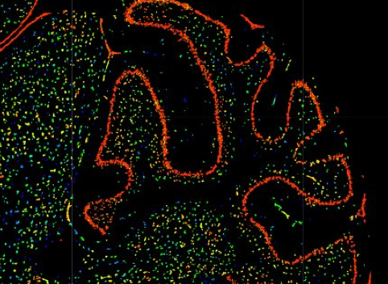
Validations that Proscillaridin A targets ATXN2
ATXN2 RNA abundance is lowered by proscillaridin A
Adding the ATP1A2 increased ATXN2
ATP1A2

Slide 16
SCA2 ASO drug action
ASO = antisense oligonucleotide
“magic bullets”
SCA2 ASO eliminates ATXN2 RNA.
Isis Pharmaceuticals
Notes:
The ataxin-2 mutation leads to a gain of function for the gene and much that we know about SCA2 biology indicates that destroying the gene function would be therapeutic for this disease.
Isis Pharmaceuticals are leading experts on developing a type of drug called antisense oligonucleotides, or ASO drugs, that function to so-to-speak, seek-and-destroy gene function…this is really a unique approach compared to traditional drugs that work on the protein level to shut down their function. The foundation of our technology is the development of ASO drugs for SCA2 to be tested in novel SCA2 mouse models that we have made in our university laboratories.
-- Talk them thru the slide –
When the drug enters the cell it hybridizes to the RNA of the target gene stimulating a native process in the cell to degrade the target RNA; gene function is destroyed. We have preliminary data demonstrating prototype SCA2 ASOs work in mice. We deliver them by injection into the brain ventricle. Special stains tell us that the drug enters the Purkinje cells, which is the cell type that is compromised in SCA2 patients, and we have observed lower ATXN2 expression with increasing drug dose.
In patients ASO drugs can be delivered with intrathecal pumps to the spinal fluid where the drug will diffuse to the brain. The University of Utah Department of Neurology is currently participating in a clinical trial on spinal muscular atrophy with Isis Pharmaceuticals where this method is being used.
We also have micropumps allowing us to model this in mice.

Slide 17
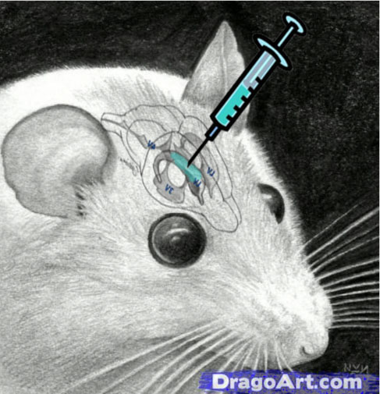
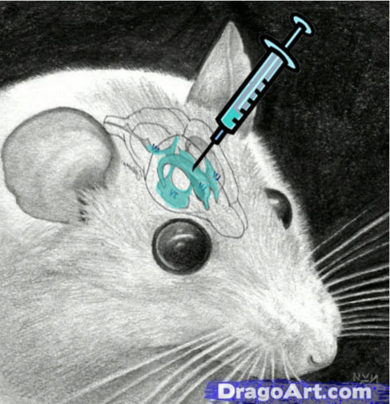
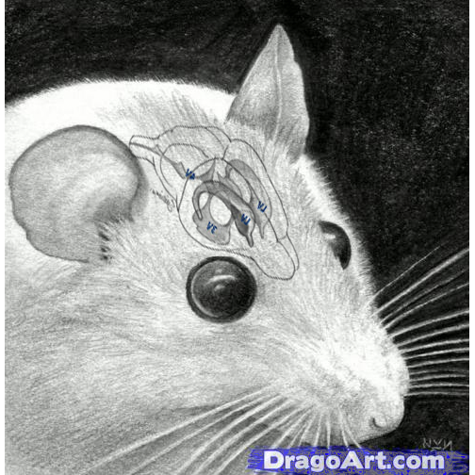
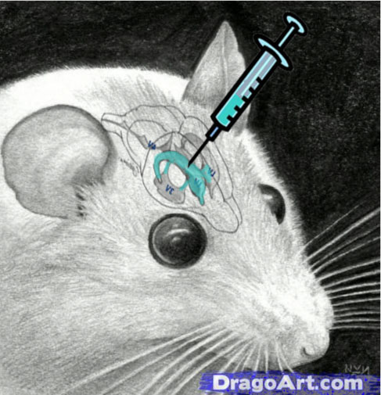
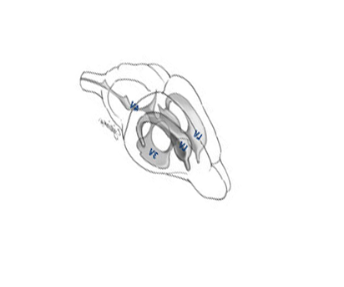
Intracerebroventricular (ICV) Injection
Transgenic mouse with human ATXN2 gene

Slide 18
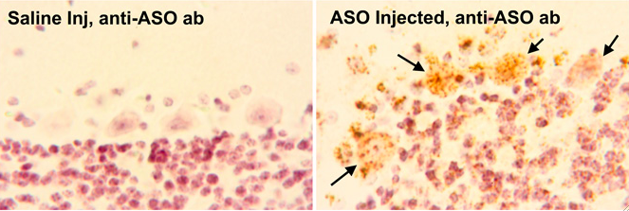
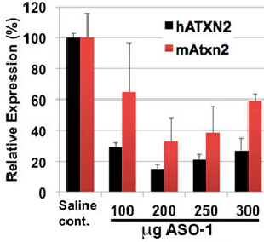
SCA2 ASO enter Purkinje cells and lowers ATXN2 expression
Immunohistochemical Staining
ATXN2 RNA
Notes:
Anticipation – genotype phenotype correlation with generation component
ATXN2 vulnerabilities

Slide 19
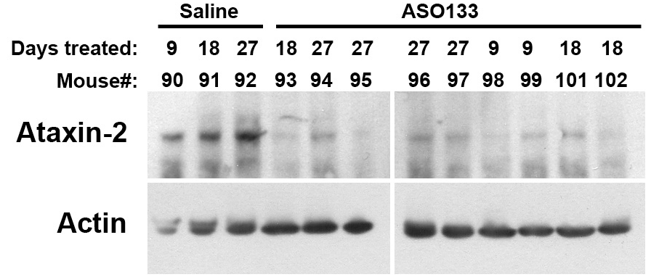
Timecourse using 200 μg ASO
RNA
Protein
N=3
Saline
ASO

Slide 20
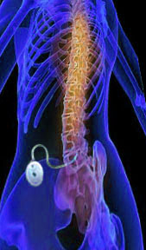
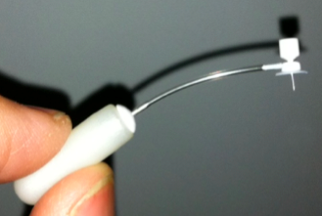
SCA2 ASO drug delivery
ASOs are delivered by pump into the patient spinal fluid.
Micro-pump for mice.
Spinal Muscular Atrophy
ISIS clinical trial
Notes:
The ataxin-2 mutation leads to a gain of function for the gene and much that we know about SCA2 biology indicates that destroying the gene function would be therapeutic for this disease.
Isis Pharmaceuticals are leading experts on developing a type of drug called antisense oligonucleotides, or ASO drugs, that function to so-to-speak, seek-and-destroy gene function…this is really a unique approach compared to traditional drugs that work on the protein level to shut down their function. The foundation of our technology is the development of ASO drugs for SCA2 to be tested in novel SCA2 mouse models that we have made in our university laboratories.
-- Talk them thru the slide –
When the drug enters the cell it hybridizes to the RNA of the target gene stimulating a native process in the cell to degrade the target RNA; gene function is destroyed. We have preliminary data demonstrating prototype SCA2 ASOs work in mice. We deliver them by injection into the brain ventricle. Special stains tell us that the drug enters the Purkinje cells, which is the cell type that is compromised in SCA2 patients, and we have observed lower ATXN2 expression with increasing drug dose.
In patients ASO drugs can be delivered with intrathecal pumps to the spinal fluid where the drug will diffuse to the brain. The University of Utah Department of Neurology is currently participating in a clinical trial on spinal muscular atrophy with Isis Pharmaceuticals where this method is being used.
We also have micropumps allowing us to model this in mice.

Slide 21
A selection of active HD studies
ProjectReporter.nih.gov
Investigator | Type | Affiliation | Study
Chan | R24 | Emory | HD monkey development
McBride | R00 | Oregon Primate Center | RNAi in the HD monkey
Gottesfeld | U01 | Scripps | HDAC inhibitors
Greenhouse | R43 | Nanosyn, Inc. | Autophagy inducers
Hook | R21 | UCSD | Natural compounds and HTT function
Kaplitt | R01 | Cornell | AAV-XIAP for HD
Disney | R03 | Scripps Florida | Compounds targeting HTT polyQ
Corey | R01 | University of Texas | ASOs and RNAi targeting HTT polyQ
For ongoing clinical trials →
ClinicalTrials.gov

Slide 22
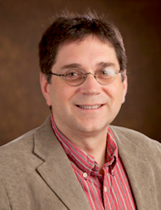
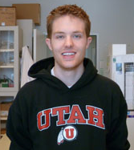
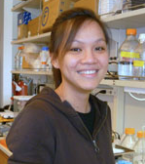
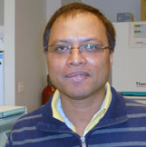
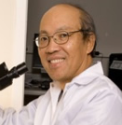
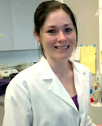
Our Team
Daniel Scoles, Associate Professor, University of Utah
Stefan Pulst, Chair of Neurology, University of Utah
Discoverer of the SCA2 gene
Notes:
We come together as a team with all the components needed to developing this technology successfully.
Gene Hung, the Executive Director of Molecular Pathology at ISIS Pharmaceuticals, has years of experience on approaches to gene therapy including ASO drug development.
I have nearly 2 decades of research experience in preclinical neuroscience, and have undergone specialized training at Isis Pharmaceuticals on the surgical delivery of ASO drugs to mice.
Dr. Stefan Pulst is a neurologist and neuro-geneticist and has cared for SCA2 patients for 3 decades . He discovered the SCA2 gene in 1996, maintains a clinic for ataxia, is an expert on clinical trials, and has experience in finance and management. The Department of Neurology has more than doubled its margin since Dr. Pulst became Chair in 2007.

