Slide 1
Status of ATXN2 ASO discovery for SCA2

Slide 2
Spinocerebellar Ataxia Type 2 (SCA2)
Lowering ataxin-2 expression may be therapeutic for SCA2.
Supported by
Toxic gain of function for mutant ATXN2
SCA2 phenotype – ATXN2 dose relationship
ATXN2 homozygosity → more severe SCA2 Reversibility in animal models (SCA1, SCA3)
Therapeutics in mice improve phenotypes (HD, SCA3)
Notes:
One of the principal objectives of our laboratory is the identification of treatments for spinocerebellar ataxia type 2 (SCA2). Presently there are no treatments for this disease.
SCA2 is a dominantly inherited polyglutamine disorder that is caused by CAG expansion mutation in the ATXN2 gene.
Patients are characterized by gait ataxia, frontal executive dysfunction, slow saccades, and rarely mutation of the ATXN2 gene is associated with DOPA-responsive parkinsonism.
A-of-O is characterized by anticipation where CAG lengths of 22-23 are normal and >32 is disease causing, and the longer the repeat length the greater the severity.
SCA2 is also characterized by PC death, and gain of toxic function.

Slide 3
MOE antisense oligonucleotide (ASO) structure and action
“MOE Gapmer”
MOE
PS
ASOs stimulate RNase H
MOE
5 bp 10 bp 5 bp
2’-O-methoxyethyl (MOE)
mRNA
ASO
O
BASE
RNase H
OCH
Cleaved mRNA
O
O
3
O
PS
P
Intact ASO
-
2’-MOE
S
O
Notes:
Here is the structure of the ASOs we are using and how they work.
These ASOs are the MOE gapmer variety
They have modified nucleotides, including the O-methoxyethyl modification at the 2’ position, and a phosphorothioate backbone.
The MOE modification enhances ASO stability and inclusion of a 10 bp gap of regular phosphorothioate ensures RNase H destruction of target mRNAs

Slide 4
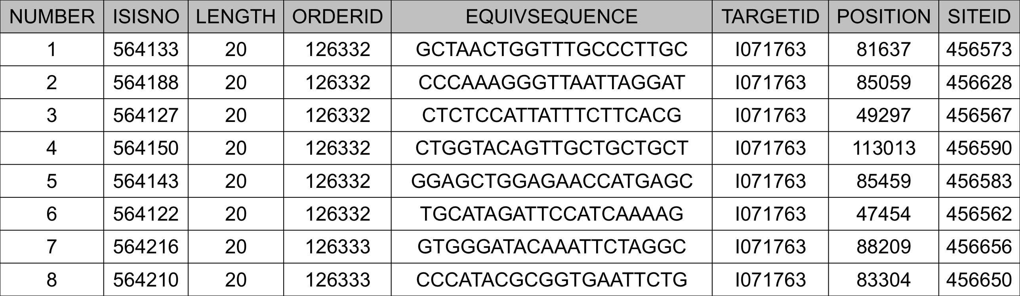
ASO Lead Table
ASO code
ASO 564133 human Exon 8 mouse Exon 8
ASO 564188 human Intron 9 mouse Intron 9
ASO 564127 human Exon 5 mouse Exon 5
ASO 564150 human Exon 16 mouse Exon 16
ASO 564143 human Exon 10 mouse Exon 10
ASO 564122 human Exon 8 mouse Exon 8
ASO 564216 human Exon 11 mouse exon 11
ASO 564210 human Exon 9 mouse exon 9 but with 4 mismatches

Slide 5
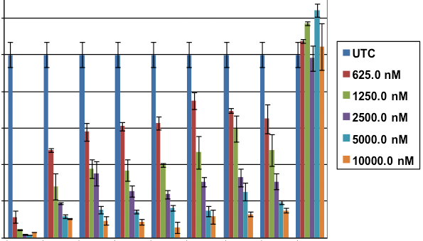
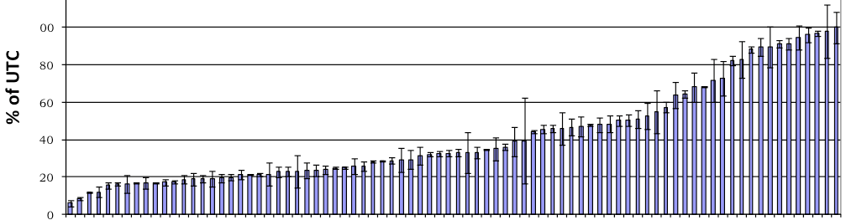
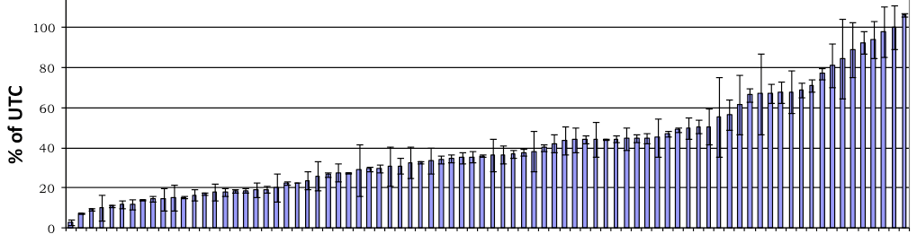
In vitro screen for ATXN2 ASOs
8 Top Lead ASOs
152 ASOs screened
120
100
15 LEADS
% of UTC
80
100
Plate 1
80
60
% of UTC
60
40
40
20
0
ASOs
UTC
20
Plate 2
0
100
neg.
cont.
80
ASO# 1 2 3 4 5 6 7 8
% of UTC
60
40
IC50 (μM) 0.5 0.6 0.8 0.8 0.9 1.3 0.6 1.3
20
0
ASOs
UTC
4.5 μM ASO
HepG2 cells
In collaboration with ISIS Pharmaceuticals, Carlsbad CA
Notes:
In collaboration with ISIS Pharmaceuticals, we screened 152 ASOs designed to specifically target human ATXN2.
Next we did dosewise tests to determine IC50s for the top 15 lead ASOs. 8 of the leads were advanced to the next level of testing.

Slide 6
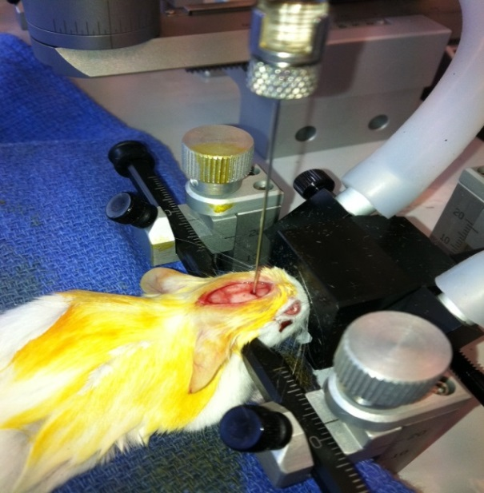
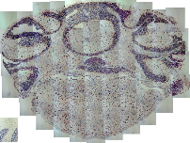
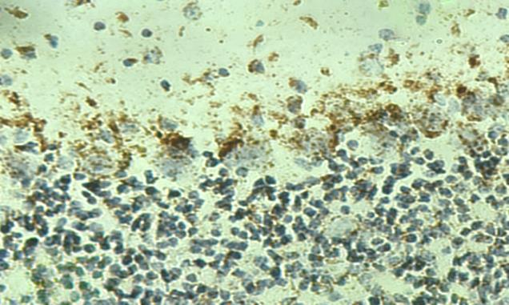
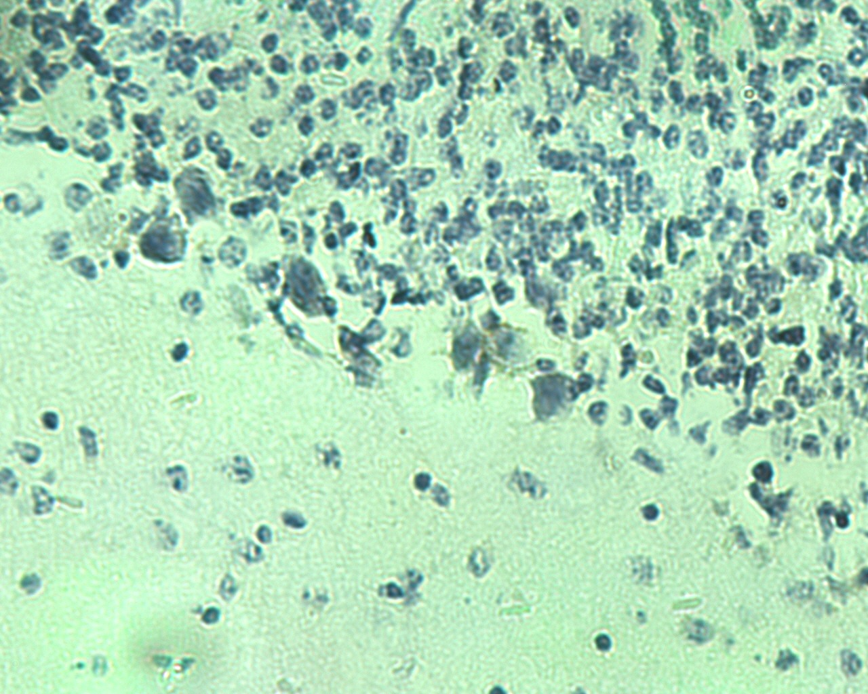
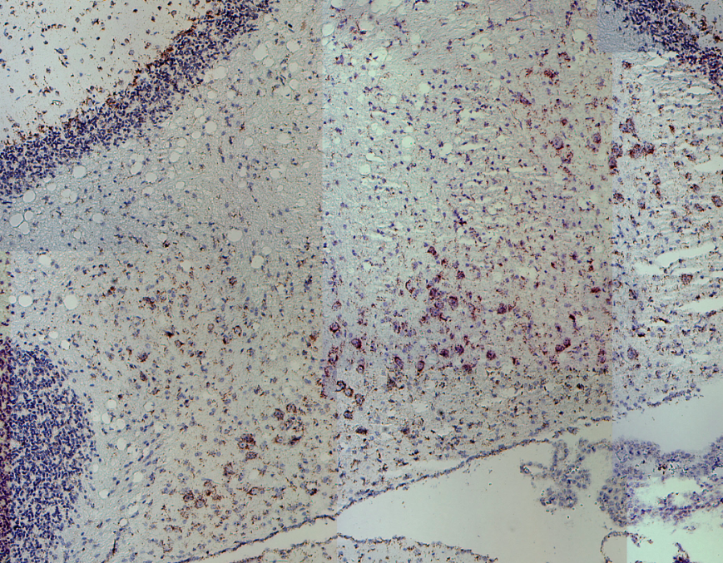
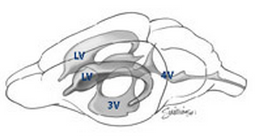
ASOs are taken up by PCs & deep cerebellar neurons
Intracerebroventricular (ICV) Injection
Staining with anti-ASO antibody
Coronal Section of Cerebellum
Purkinje cell layer
ASO injected
Deep Cerebellar Nuclei
JAX
Saline injected
Right Lateral Ventricle
Notes:
ASOs were delivered into the right lateral ventricle of our various SCA2 mouse models by intracerebroventricular injection. This was done using an isoflurane gas anesthesia system.
ASOs do not enter all cell types with the same efficiency, therefore we evaluated ASOs in injected brains for localization in Purkinje cells and deep cerebellar nuclei, using a specialized anti-ASO antibody developed by Isis Pharmaceuticals.
The result showed that the ASOs enter cells relevant to SCA2

Slide 7
Lowering of ATXN2 expression by the lead ASOs
hATXN2
mAtxn2
250 μg ASO
7d, qPCR,
n=2-3,
mean±SD.
BAC
SCA2-Q22
(FVB)
Sal
133
188
127
150
122
Sal
133
188
127
150
122
% ATXN2 Expression
ASO
ASO
Pcp2-
ATXN2-Q127
(B6/D2)
(Hansen et al., 2013)
Sal
133
127
216
210
Sal
133
127
216
210
ASO
ASO
Notes:
We evaluated the leads for target knockdown in vivo in multiple types of mice.
Our BAC mice possess the entire 176 kb ATXN2 gene region, including 16 kb upstream sequence and 2.5 kb downstream sequence. We also have a Q72 version in which ASOs work similarly. Notice that the pattern of human or mouse ATXN2 reduction was similar for the different ASOs tested.
We also evaluated selected leads in ATXN2-Q127 transgenic mice, that have ATXN2 expressed under the control of the Purkinje cell specific promoter PCP2. These mice have well defined SCA2 neurophysiological, molecular, and motor phenotypes. Again lead ASOs had similar effects on both human and mouse ATXN2.
The rest of the presentation will focus on ASO leads 1, 3 and 7, and all in vivo work from this point forward utilized ATXN2-Q127 transgenic mice.

Slide 8
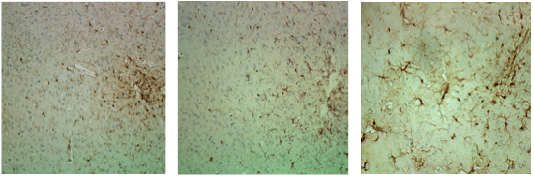
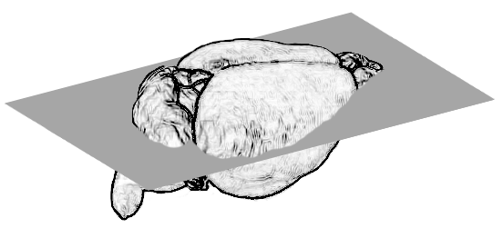
Evaluating Iba1 expression for microgliosis in ATXN2-Q127 mice
Microgliosis
Iba1 Staining
Saline
ASO133
ASO210
% Iba1 / Actin
Sal
133
127
216
210
ASO
Injection site
200 μg ASO
qPCR
N=2-11
7 days
mean±SD
Axial
Notes:
So far our evaluation of toxicity included qPCR and immunohistochemical staining for the microgliosis marker Iba1, and staining for GFAP as well but I did not include any GFAP data in the presentation. ASO8 consistently elevates Iba1 expression, serving as a positive control for toxicity. The other ASO leads were not significantly different than for saline injection, although saline alone does elevate Iba1 at the site of injection. Staining for Iba1 in ASO8 injected mice indicated a wider spread of reactive microglia.
We observed no evidence of toxicity for ASOs 1 3 and 7.

Slide 9
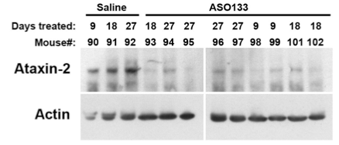
ASOs reduce ATXN2 expression in ATXN2-Q127 mice
Time course study
ICV 200 μg ASO-133
Dosing study:
ICV injection of increasing doses
of ASO-133, treated 7 days.
qPCR
N=3-7
ATXN2
Actin
DAYS
Western blot
Saline ASO-133
ATXN2
μg ASO-133
Actin
Notes:
Next we wanted to understand dose and timing of effects.
Here I’m only showing you data for ASO-1. For 7 days treatment time, we saw the best reduction of ATXN2 expression for 200 ug ASO. Mouse ATXN2 was always a little bit higher. Therefore we utilized 200 ug for our long term experiments.
A timecourse study showed that human ATXN2 was maximally reduced after 18 days but atxn2 stayed 65% reduced after 84 days treatment time.
The ASO effects could also be easily seen by western blotting.

Slide 10
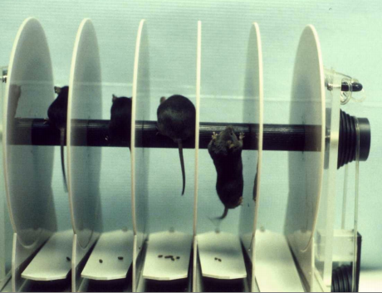
ASO effects on SCA2 motor phenotypes
Accelerating rotarod
Day 1 Handle mice 2 x 3 minutes
Day 2 Introduce mice to rotarod x 2
      1 min 5 rpm then increase 1 rpm every 15 seconds to 10 RPM, maintain 10 RPM until 4 min.
Day 3-5 Rotarod Tests x 3
      0-40 RPM over 6 minutes
      (1 RPM increase per 9 s)
For all, mice are brought to the testing area at noon and acclimated for one hour before testing begins. Testing is completed before 5 pm.

Slide 11
ASO133 impaired the SCA2 rotarod phenotype
ATXN2-Q127 mice
12 wks treatment
200 μg ASO133
1 2 3
1 2 3
Week 6
Week 12
SET2
Means and SE

Slide 12

ASO133 improved the molecular phenotype
Expression in Cerebellar Extracts
hATXN2
**
**
ATXN2-Q127 mice
12 wks treatment
200 μg ASO133
N=7 for qPCR
*
ns
Expression relative to actin
*
ns
SET2

Slide 13
Lower doses of ASO133 did not impair or improve the rotarod phenotype
Week 5 Week 14
(Week 9)
MATT1
N=15 mice/group
Means and SE

Slide 14
ATXN2 was reduced in a dosewise manner in MATT1 mice
14 wks treatment
N=15 mice/group
ATXN2 / Actin
Saline 50 μg 100 μg
ASO133 ASO133

Slide 15
Considerations on the next experiment
Despite the improvement of the molecular phenotype when using ASO133, this ASO impared the rotarod phenotype.
Therefore we decided to evaluate the two next best ASOs in the next experiment, MATT2:

Slide 16
ASOs 127 and 216 used in MATT2
Just a reminder of what we saw in preliminary in vivo testing
hATXN2
mAtxn2
250 μg ASO
7d, qPCR,
n=2-3,
mean±SD.
BAC
SCA2-Q22
(FVB)
Sal
133
188
127
150
122
Sal
133
188
127
150
122
% ATXN2 Expression
ASO
ASO
Pcp2-
ATXN2-Q127
(B6/D2)
(Hansen et al., 2013)
Sal
133
127
216
210
Sal
133
127
216
210
ASO
ASO
Notes:
We evaluated the leads for target knockdown in vivo in multiple types of mice.
Our BAC mice possess the entire 176 kb ATXN2 gene region, including 16 kb upstream sequence and 2.5 kb downstream sequence. We also have a Q72 version in which ASOs work similarly. Notice that the pattern of human or mouse ATXN2 reduction was similar for the different ASOs tested.
We also evaluated selected leads in ATXN2-Q127 transgenic mice, that have ATXN2 expressed under the control of the Purkinje cell specific promoter PCP2. These mice have well defined SCA2 neurophysiological, molecular, and motor phenotypes. Again lead ASOs had similar effects on both human and mouse ATXN2.
The rest of the presentation will focus on ASO leads 1, 3 and 7, and all in vivo work from this point forward utilized ATXN2-Q127 transgenic mice.

Slide 17
Rotarod testing using ASOs 127 and 216: MATT2
It was these ASO216 mice that were used in the first ephys analysis
<0.05 <0.05 <0.01
← ASO216 vs SAL
N
ATXN2-Q127 mice
200 μg ASO216 or ASO127
13
15
15
MATT2
Means and SE

Slide 18
ATXN2 expression for the MATT2 mice
Expression after 13 weeks of ASO treatment
MATT2

Slide 19
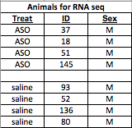
Ongoing MATT2 RNA-seq study
Mice selected
and qPCR validation
MATT2

Slide 20
Rotarod testing including a wildtype group: MATT3
There appears to be a washing out effect
TG and WT littermates
250 μg ASO216
N=11-12
<0.05
Means and SE
MATT3

Slide 21
Considerations on the next experiment
Because we saw evidence of ASO washout we decided to use a larger N per group and do multiple ASO treatments in the next experiment, MATT4:

Slide 22
Ongoing rotarod study
N at study initiation: 30 Saline 30 ASO
Mortality: -5 saline -1 ASO
Sent to Meera: -2 saline -2 ASO
Present N: 23 saline 27 ASO
MATT4

Slide 23

Conclusions and the Future
CONCLUSIONS
ASOs have a prolonged effect, improve PC health markers, and SCA2 mouse phenotypes.
MATT4 COMPLETION
MATT4 analysis will include calbindin staining for molecular layer health, PC genes by qPCR, expression of ATXN2 in spinal column.
FUTURE WORK
As outlined in our contract with Isis:
Evaluation of additional doses and times to identify conditions for maximal ASO effect on modifying the SCA2 phenotype.
Modifying ASO chemistry
Additional animal models (FLAG-ATXN2-Q129)
RNA-seq analysis for evaluating off-target effects

Slide 24
Itpr1 ASO testing

Slide 25
Itpr1 ASOs lower Itpr1 mRNA abundance
N=3 males and 3 females per treatment, all wildtype mice
250 μg ASO treated for 7 days
qPCR

Slide 26
ASO use in BAC Q72 mice

Slide 27
ASO-216 effect on lowering ATXN2 in BAC Q72 mice
ATXN2
mAtxn2
Iba1
Mice were treated with 250 ug ASO216 for 7 days
N=3 SAL 4 ASO

