Slide 1
P01 Alternatives

Slide 2
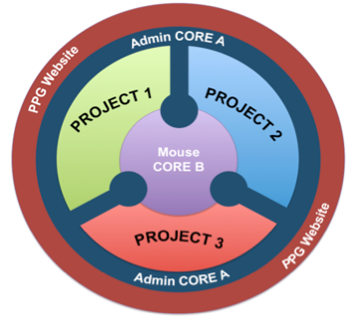
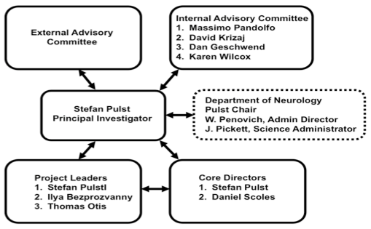
P01 Summary
Pulst
Ilya
Otis
Overview Pulst
Core A Pulst
Core B Scoles
Project 1 Pulst Transcriptome & rotarod // ATXN2 ASO & P2 & P3 compounds
Project 2 Ilya Various phenotypes // ITPR ASO, LMWH, NS13001, calbindin, parvalbumin
Project 3 Otis Circuits, E-Phys // P1 P2 compounds targeting mGluR/Ca2+ cascade, JnJ cmp

Slide 3
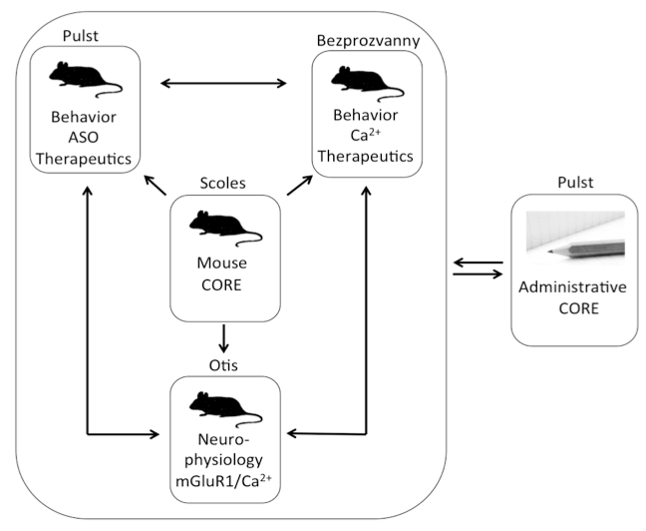
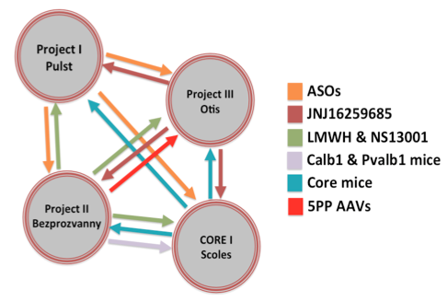
P01 Summary

Slide 4
An R01 could have an appearance of overalp with the existing R37
The R01 built on PPG ideas
R37 Aims
Aim 1
Project 1 with elements of Project 2
ATXN2 ASO
ITPR1 ASO
Rotarod, transcriptome, histopathology
Aim 2
Project 3
E Phys analysis of mGluR/Ca2+ cascade
Aim 3
Something on RGS8 to follow-up on BAC paper findings
Aim 1
Calcium homeostasis and mGluR1 signaling in SCA2 mouse models
A) correlate PC firing rate and intracellular calcium
B) E-Phys and behavioral changes induced by mutant ATXN2 in mGlur +/- mice
Aim 2
Identification of novel pathways in SCA2 disease initiation
A) RNA-seq of Q127 mice
B) RNA-seq of mice in SA1B
C) AAV delivery of 5 genes + RGS8 and evaluate phenotypes

Slide 5
Informational blog:
http://blog.ninds.nih.gov/2014/08/13/ninds-launches-new-translational-funding-programs/
Decision Tree to help decide the most appropriate PAR:
http://www.ninds.nih.gov/funding/areas/translational_research/

Slide 6
CREATE BPN
For Small Molecules:
http://grants.nih.gov/grants/guide/pa-files/PAR-14-293.html
NINDS and NIH Blueprint for Neuroscience Research
CREATE BIO
ASOs:
http://grants.nih.gov/grants/guide/pa-files/PAR-14-288.html
NINDS only

Slide 7
BPN Schematic
CREATE BIO is similar to CREATE BPN
Both use a UH2/UH3 model:
Preparatory Activities:
Required entry, an up to
1 year Phase I UH2
Total project not to exceed 5 years
From: http://neuroscienceblueprint.nih.gov/resources/projectSchematic.htm

