Slide 1
Friday February 22, 2013
PPG meeting

Slide 2
NCGC compound screen progress
qHTS
Result
Primary Screen (1536 well plates)
ATXN2-luc, 7 doses
Celltiter Fluor
Secondary Screen
Recombinant luciferase
CMV-luciferase
ATXN2-lac repressor / lacOp-luc
AROSA-luciferase
2600 active compounds from the primary screen
1-“ordered 27 compounds and owe you the data and more compounds”
2-“powders ordered”
AROSA

Slide 3
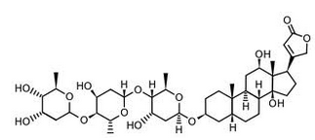
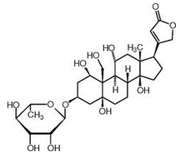
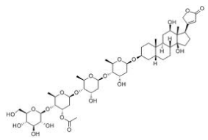
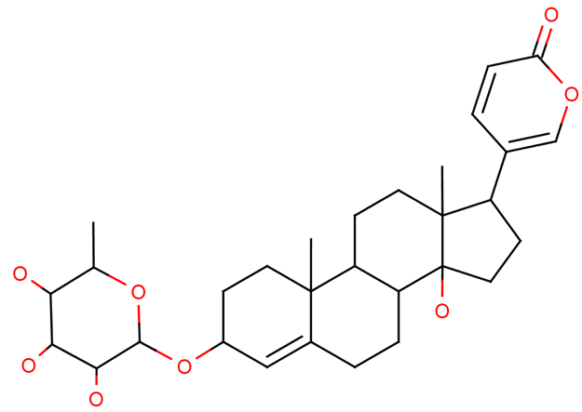
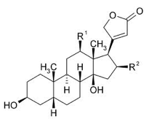
Proscillaridin A inhibits ATXN2-luc
Digoxin
Proscillaridin A
foxglove
Ouabain
Lanatoside C
Digitalis
SH-SY5Y cells, 48 hours

Slide 4
SH-SY5Y cells treated with Proscillaridin A 48 hrs
Endogenous ATXN2 by qPCR

Slide 5
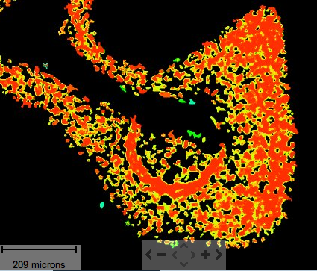
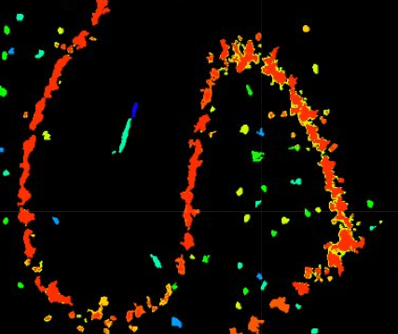
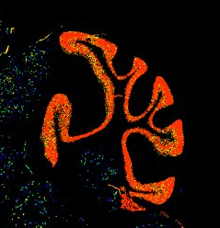
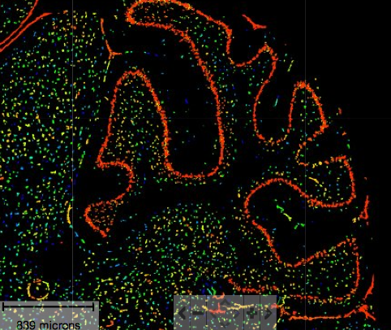
ATP1A2 is a possible proscillaridin target expressed in Purkinje cells (Allen Atlas)
ATP1A1
ATP1A2
(ATP1A3 looks like ATP1A1)

Slide 6
Effect of overexpressing ATP1A2 on ATXN2-luc expression in stably transfected SH-SY5Y cells (S2 cells).
ATXN2-luc
Cell numbers
Ratio x 10^7
N=4 transfections
pCMV6-ATP1A2 purchased from Origene

Slide 7
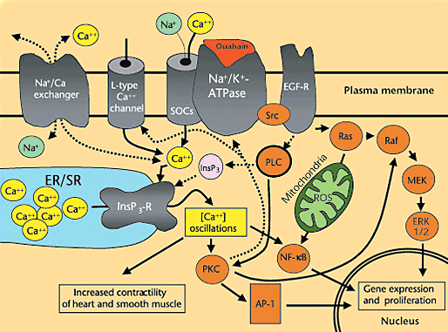
Na-K-ATPases alter calcium signaling
ATP1a1
Rat kidney
Store operated channels (SOCs)
Nature Medicine 7, 1288 - 1289 (2001)

Slide 8
Dantrolene reduces ATXN2-luc expression
16% reduction
P<0.001 ANOVA Multiple pairwise doses are significantly different (Bonferroni).
Calcium
Ionomycin
Notes:
----- Meeting Notes (2/22/13 22:01) -----
NFAT luc construct… classic
stim2 in er --the calcium sensor
tripC1- Ilya has ko mice
moonwalker mice tripc3
pc excited by mglur b/c tripc3 channel opening
SOC inhibitor

Slide 9
Stress granules and ataxin-2 function

Slide 10
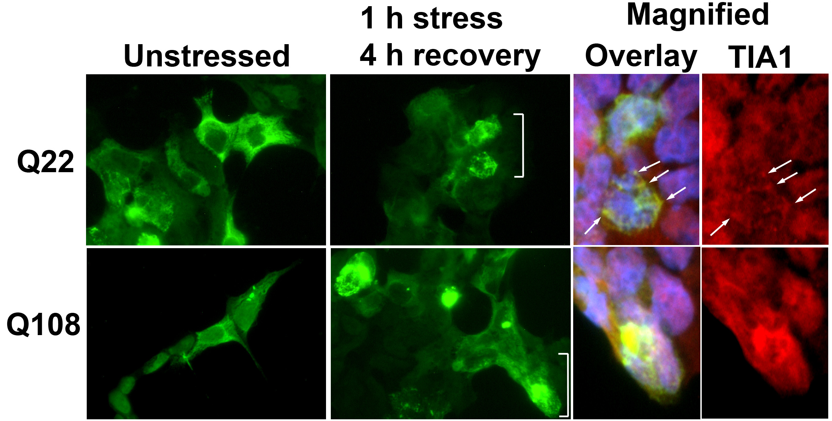
Ataxin-2 with the expanded CAG repeats accumulate in stress granules more and cause longer SG half-life.
0.5 mM Sodium arsenate

Slide 11
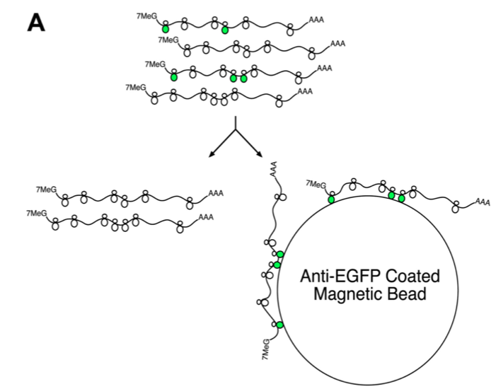
Evaluating ATXN2 effect on the mRNAs in translating polysomes
X
DR166 mouse
GFP-L10a
ATXN2-Q127
Stress granules possess mRNAs on the small ribosomal subunit and associated proteins, thus GFP-L10a pull-down is not expected to include SG mRNAs.
A future goal will be to pull down SGs with another strategy to evaluate ATXN2 mutation effect on mRNAs in SGs
Deep Sequencing
Heiman et al. Nathaniel Heintz.
Cell. 2008, 135(4): 738–748.
Notes:
----- Meeting Notes (2/22/13 22:01) -----
channel genes and changes

Slide 12
ATXN2 ASOs

Slide 13
ASO studies using ATXN2-Q127 Tg B6 mice
ASO selection study
Injected with different ASOs,
250 μg, treated 7 days*.
Dosing study
Injected with increasing doses
of ASO 133, treated 7 days.
Timecourse study
Injected with 200 μg ASO 133
5.7 μl of 35 μl/ml ASO.
3
3
3
3
← N
*
* The saline group consisted of one 9d mouse, one 18d mouse, & one 27d mouse.
We also have data for mouse Atxn2 showing similar pattern.
Mouse #
ASO #
μg ASO 133
* We also have paired qPCR data showing best
knockdown of mouse Atxn2 by ASO 133
N=2

