Slide 1
Saturday February 15, 2014
PPG meeting
Dan’s part

Slide 2
Compound Screening

Slide 3
Compound Screening
Our compound screening grant has ended. We received partial datasets while the technicians in the NCGC continue work to complete screens.
Last year I showed you data on the Na-K-ATPase inhibitor proscillaridin:
In cell cultures 1 and 0.1 nM proscillaridin reduced ATXN2
expression but not cell abundance
Transfection of ATP1A2 increased ATXN2 expression.
We now are treating mice with doses of proscillaridin using Alzet osmotic pumps. Study is ongoing, these mice are still alive.

Slide 4
ATXN2 ASOs

Slide 5
ASO studies using ATXN2-Q127 Tg B6 mice
Last year I showed you our data that indicated ASO133 was best for inhibiting ATXN2 expression in ATXN2 Tg mice:
Dosing study
Injected with increasing doses
of ASO 133, treated 7 days.
Timecourse study
Injected with 200 μg ASO 133
5.7 μl of 35 μl/ml ASO.
3
3
3
3
← N
*
μg ASO 133
N=2

Slide 6
More recently we are attempting to show ATXN2 ASOs reverse the SCA2 rotarod phenotype
200 ug ASO133 treated for 5 or 10 weeks yielded data like shown below. The motor phenotypes were not improved, but were more pronounced.
Rotarod test of ATXN2-Q127 Tg mice, 12 weeks post ASO-133 injection
W=WT, T=TG, S=Saline, A=ASO. N=8-10
We now have ongoing experiments to solve this problem. One experiment uses 0, 50 and 100 ug ASO133 and another experiment will evaluate two other ASOs from the selection provided by Isis Pharmaceuticals that most significantly lower ATXN2 expression in our mouse models.

Slide 7
AROSA

Slide 8
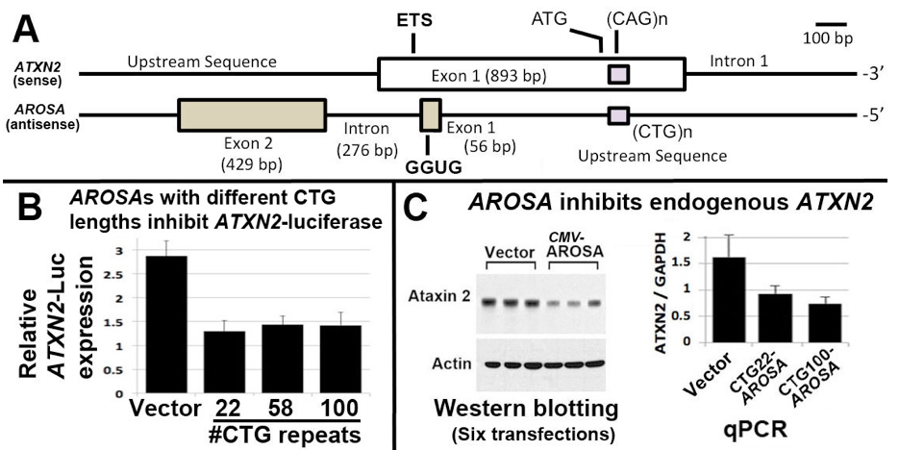
ATXN2 promoter-associated long noncoding RNA AROSA
Antisense Regulator Of Spinocerebellar Ataxia
Last year I introduced AROSA but showed very little data:
AROSA transfection inhibits ATXN2 expression
Laser capture microdissection demonstrated AROSA presence in
purkinje cell layers of ATXN2 BAC transgenic mice, but not
granule layers.

Slide 9
We now discovered literature showing FUS interacts with a cyclin D1 gene promoter associated lncRNA that negatively regulates CCND1 expression, and that the FUS interaction is mediated by a GGUG in the lncRNA. AROSA has a GGUG.

Slide 10
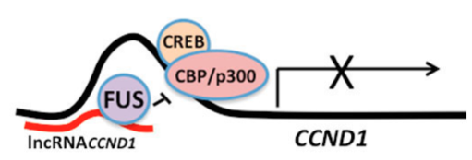
How FUS regulates CCND1:
For CCND1, the lncRNA expression is stimulated by ionizing radiation. The lncRNA then recruits FUS to the CCND1 promoter where it inhibits the histone acetyltransferase (HAT) activity of CBP/p300 which is recruited to turn on CCND1 expression by CREB.
Hypothesis for how FUS regulates ATXN2:
ATXN2 has no CREB site, but CBP/p300 interacts with ETS1.

Slide 11
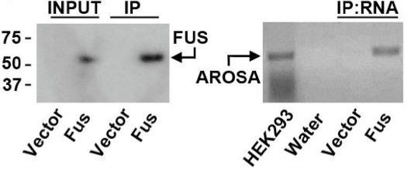
Spliced AROSA is immunoprecipitated with FUS
Anti-FLAG
RT-PCR
FUS overexpression in HEK293 as a fusion with one-strep-FLAG, immunoprecipitated using streptactin beads.
We will continue to characterize the roles of FUS and AROSA for possible therapeutic targets for SCA2 and ALS

Slide 12
Relevant literature on the AROSA part:
FUS binds lncRNACCND1 to inhibit expression
Kurokawa, R., (2011). Promoter-associated long noncoding RNAs repress transcription through a RNA binding protein TLS. Adv Exp Med Biol. 722:196-208.
Song, X., et al., (2012). Promoter-associated noncoding RNA from the CCND1 promoter. Methods Mol Biol. 809:609-22.
Scoles, D.R., et al., (2012). ETS1 regulates the expression of ATXN2. Hum Mol Genet. 21:5048-65.
Foulds, C.E., et al., (2004). Ras/mitogen-activated protein kinase signaling activates Ets-1 and Ets-2 by CBP/p300 recruitment. Mol Cell Biol. 24:10954-64.
Yang, C., et al., (1998). A role for CREB binding protein and p300 transcriptional coactivators in Ets-1 transactivation functions. Mol Cell Biol. 18:2218-29.
ATXN2 expression depends on ETS1
ETS1 interacts with CBP/p300

