Slide 1
Purkinje neurons are spontaneously active in absence of synaptic transmission
D
E
F
Hausser and Clark, 1997

Slide 2
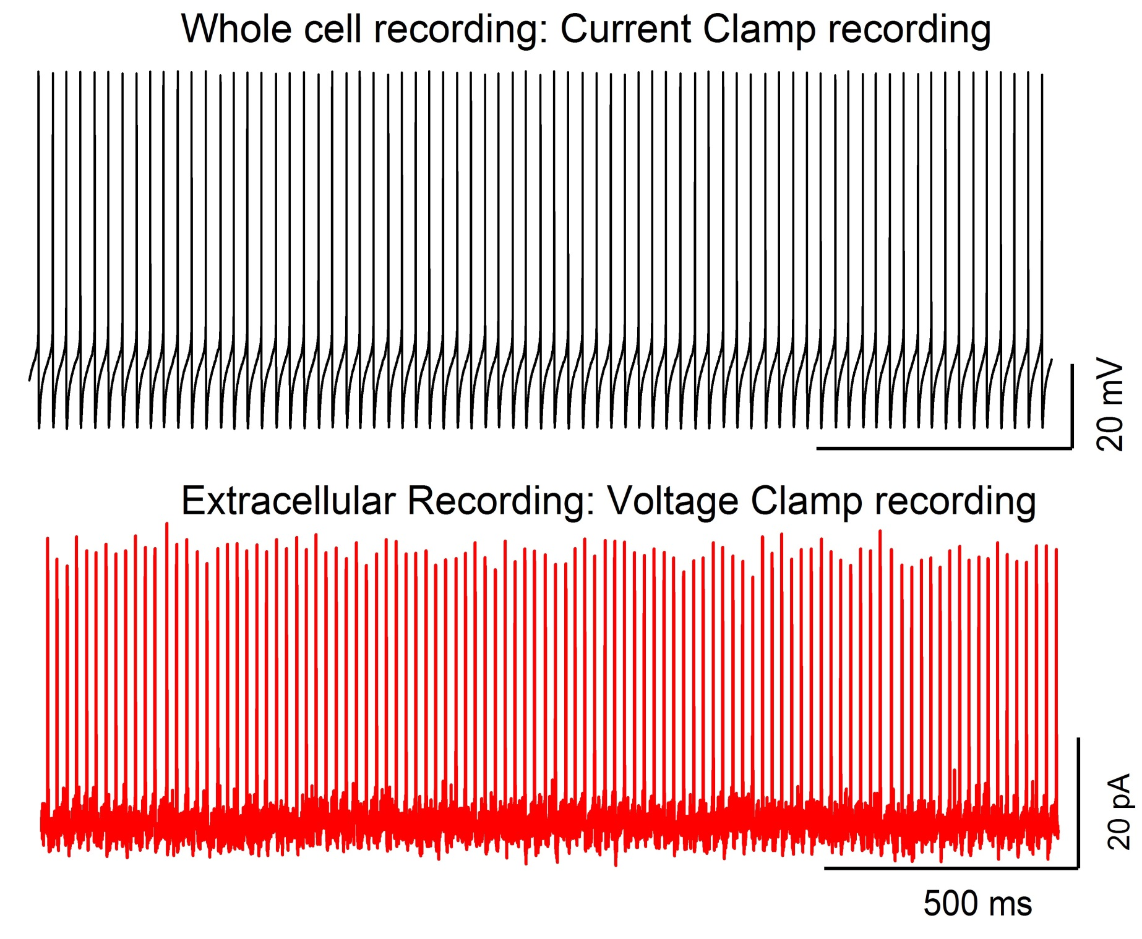
6_30_2011, cell c 40 Hz

Slide 3
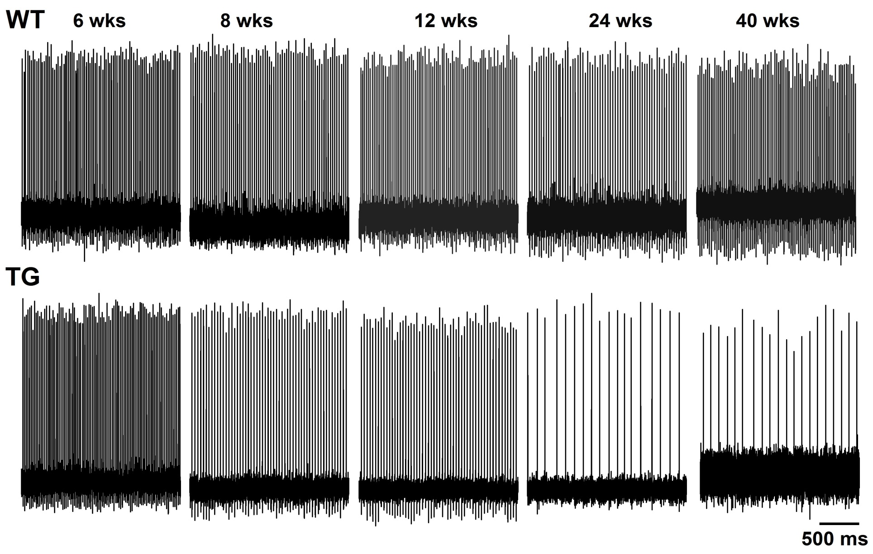
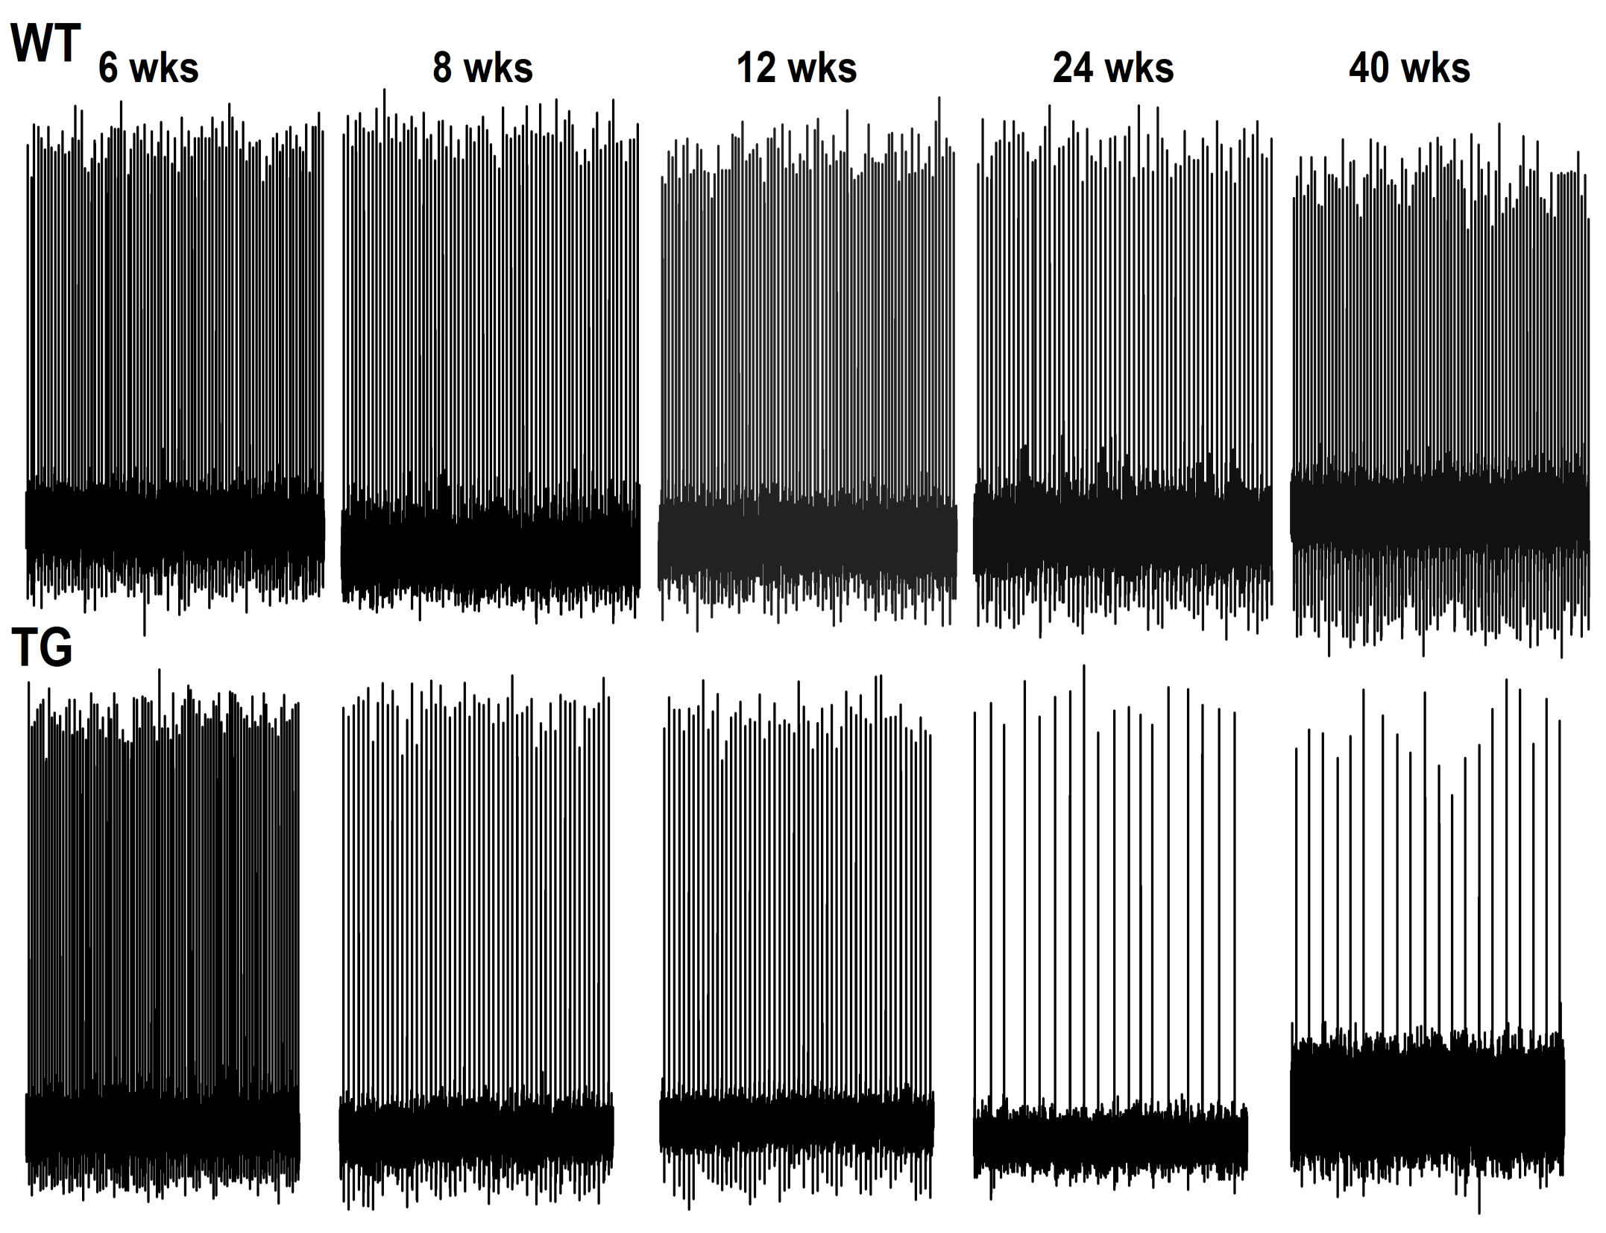
PN firing rate decreases with age in SCA2 mice

Slide 4
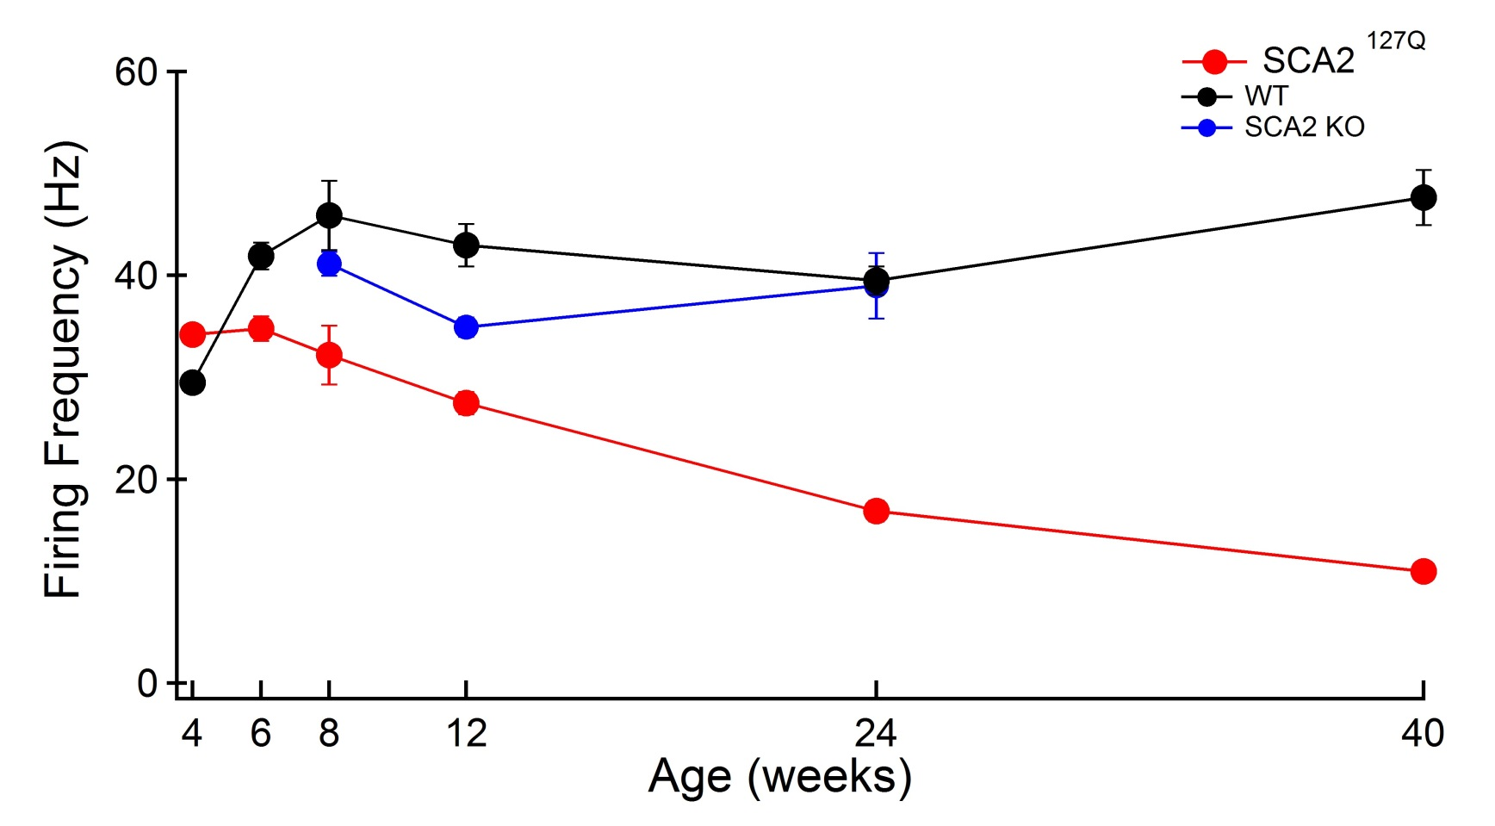
Mean Firing Rate decreases with age in SCA2 mice
Wks | WT | SCA2
4 | 30 ± 1((n =120) | 34 ± 0.9 (n = 79)
6 | 42 ± 1 (n = 73) | 35 ± 1 (n = 75)
8 | 46 ± 3 (n = 48) | 32 ± 3 (54)
12 | 43 ± 2 (n = 84 | 27 ± 1 (n = 100)
24 | 43 ± 2 (n = 59 | 17 ± 1 (n = 85)
40 | 48 ± 3 (n = 98) | 11 ± 1 (n = 82)

Slide 5
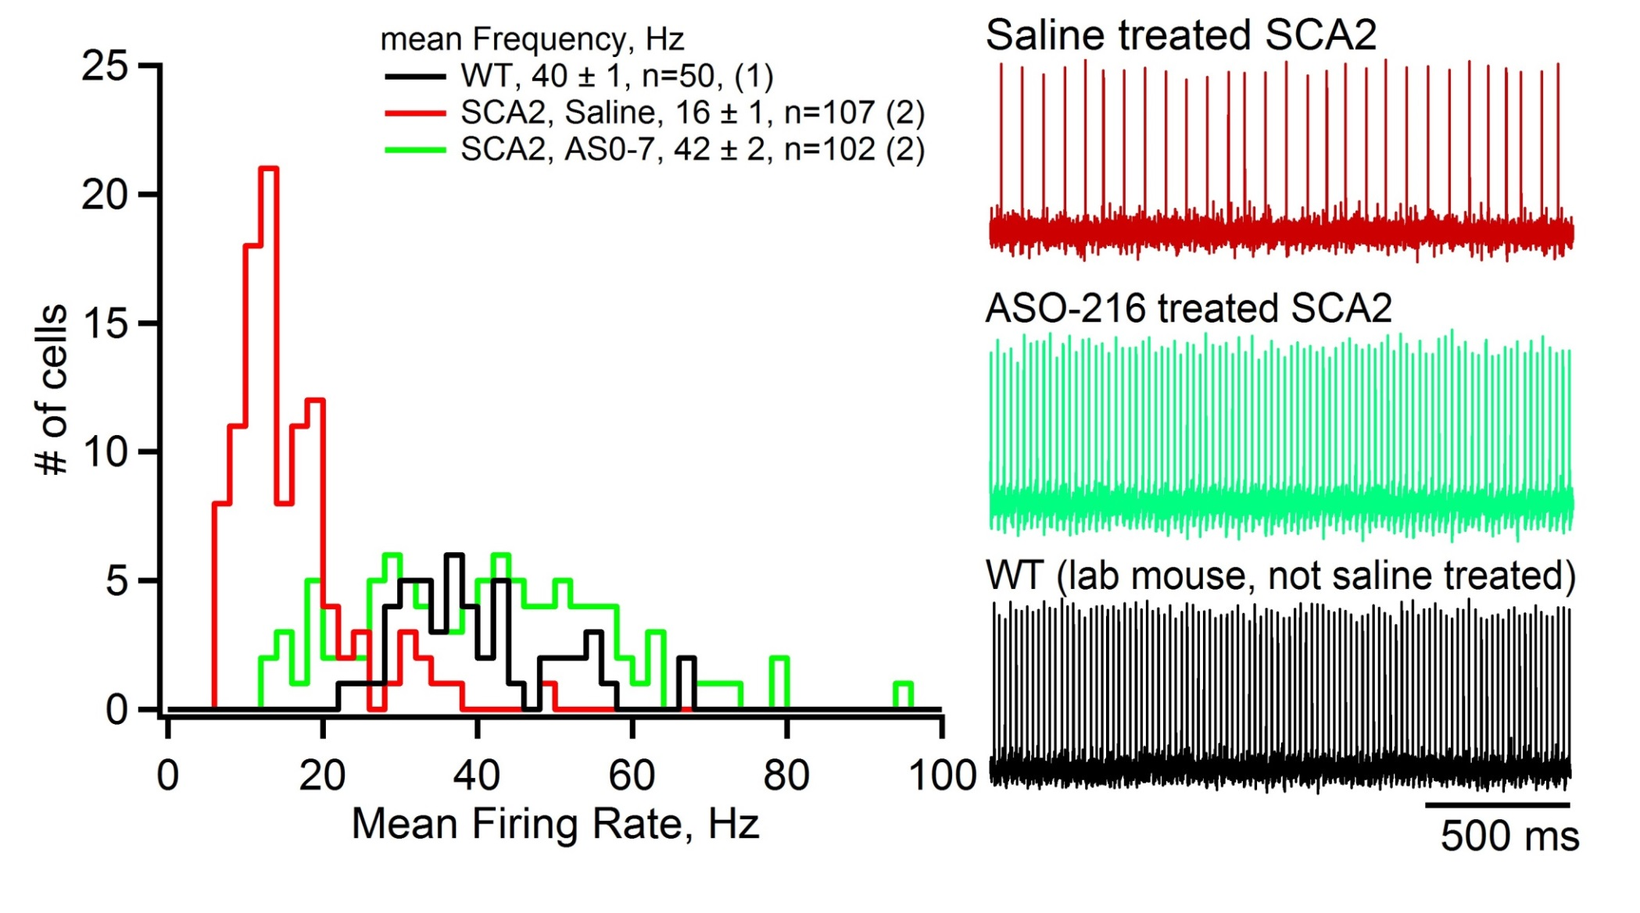
MAAT2: ASO treatment improves Purkinje neuron firing in SCA2 mice,
ASO 216 (200 ug), 13 wks post ICV
June 2014

Slide 6
DOB:3_25_2014 |  |  |  |  | Results
Expt. ID | mouseID | DATE | genotype | treatment | Mean Freq (Hz) | MeanISI (ms) | CV | CV1 | n (PN)
labWT |  | 9_9_2014 | WT |  | 40.07 | 27.31 | 0.10 | 0.07 | 27
Pulst144 | 14 | 9_12_2014 | SCA2 | ASO | 14.65 | 69.28 | 0.06 | 0.06 | 25
Pulst145 | 15 | 9_15_2014 | SCA2 | ASO | 16.99 | 64.48 | 0.05 | 0.04 | 26
Pulst153 | 17 | 11_17_2014 | SCA2 | ASO | 15.73 | 79.11 | 0.09 | 0.08 | 30
Pulst146 | 1 | 9_16_2014 | SCA2 | saline | 16.43 | 67.34 | 0.08 | 0.06 | 33
Pulst150 | 8 | 10_7_2014 | SCA2 | saline | 12.39 | 99.95 | 0.18 | 0.07 | 25
Pulst147 | 3 | 10_1_2014 | WT | saline | 38.14 | 27.61 | 0.05 | 0.06 | 25
Pulst148 | 28 | 10_2_2014 | WT | saline | 37.24 | 30.64 | 0.13 | 0.10 | 30
Pulst149 | 55 | 10_6_2014 | WT | ASO | 51.30 | 21.10 | 0.12 | 0.11 | 31
Pulst152 | 82 | 11_11_2014 | WT | ASO | 54.47 | 21.04 | 0.33 | 0.08 | 30

Slide 7
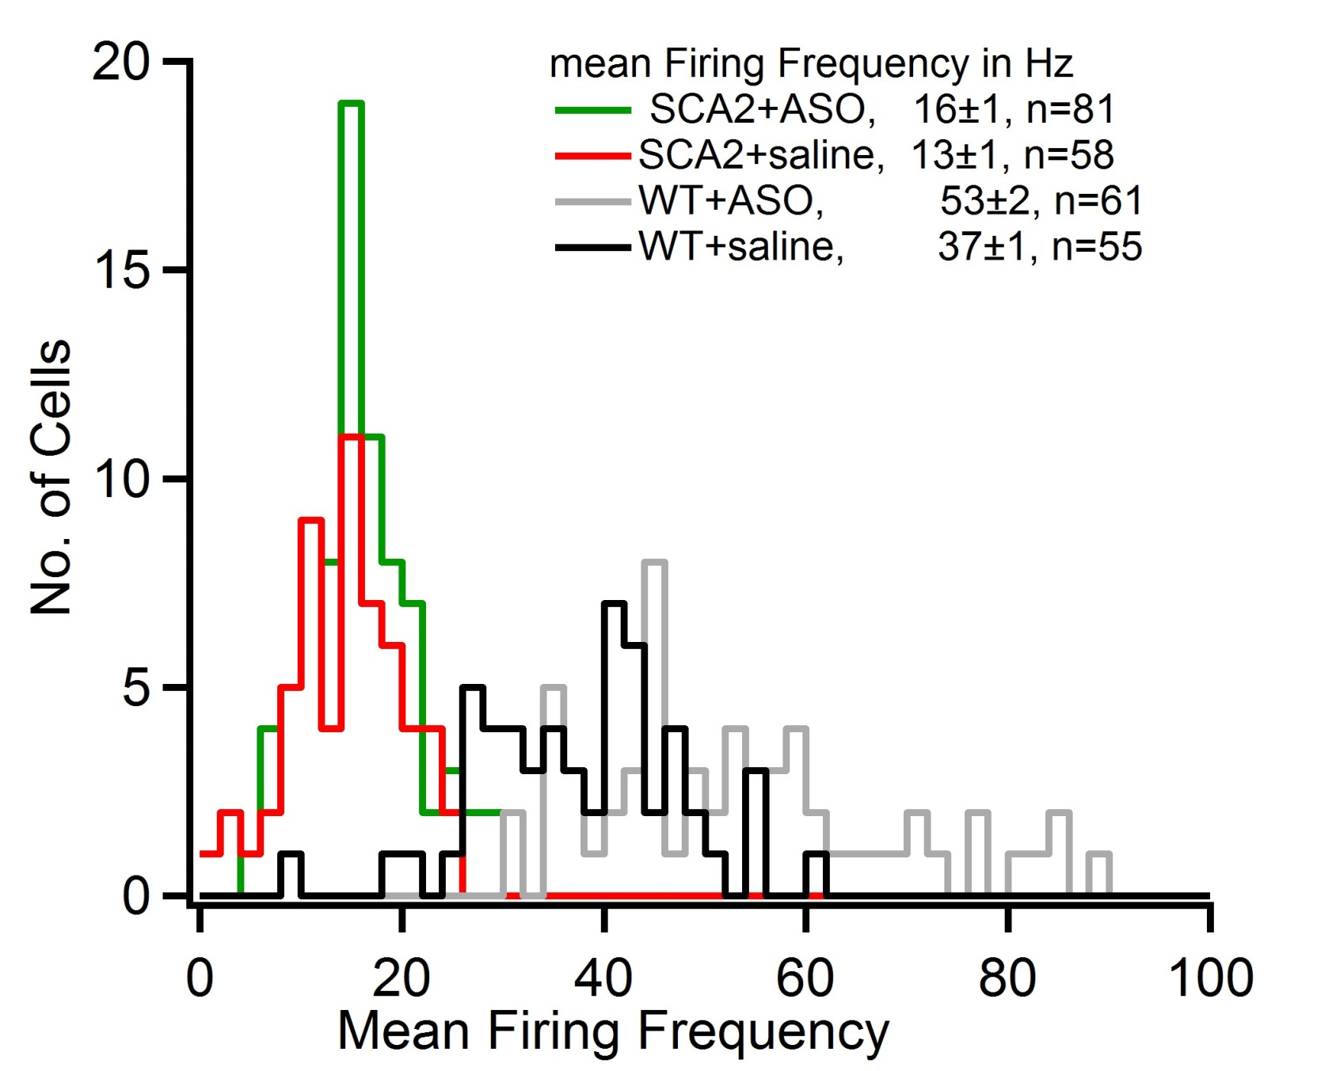
MAAT3: No effect of ASO treatment in SCA2 mice, ASO 216 (250 ug), 14⁺ wks post ICV

Slide 8
MAAT4
Initial Groups=30 TG-ASO and 30 TG-Saline Injection 210 ug ATXN2 ASO-216 Days shown are 1st Monday of the wk.
We lost some mice, as of Jan 20, 2015 N=26 ASO and 27 Saline
Dec 8 -- Rotarod test all mice.
Dec 15 -- ICV injection of all mice.
Dec 22
Dec 29
Jan 5
Jan 12
Jan 19 -- 5 wks post injection. Rotarod test.
Jan 26 -- Send 2 mice/gp to UCLA for neurophys; Reinject all remaining mice,
Feb 2
Feb 9
Feb 16
Feb 23
March 2 -- Mice are 11 wks post ICV-1. Rotarod test; Send 2 mice/gp to UCLA for neurophys
March 9 -- Mice are 12 wks post ICV-1 6 wks post ICV-2. Sac all mice and qPCR

Slide 9
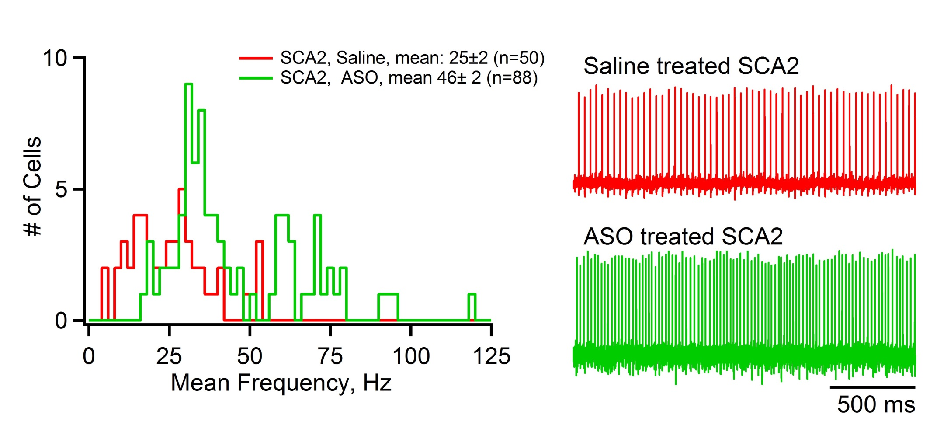
MAAT4: ASO treatment improves Purkinje neuron firing in SCA2 mice
ASO 216 (210 ug) 6 wks post ICV
Jan. 2015

Slide 10
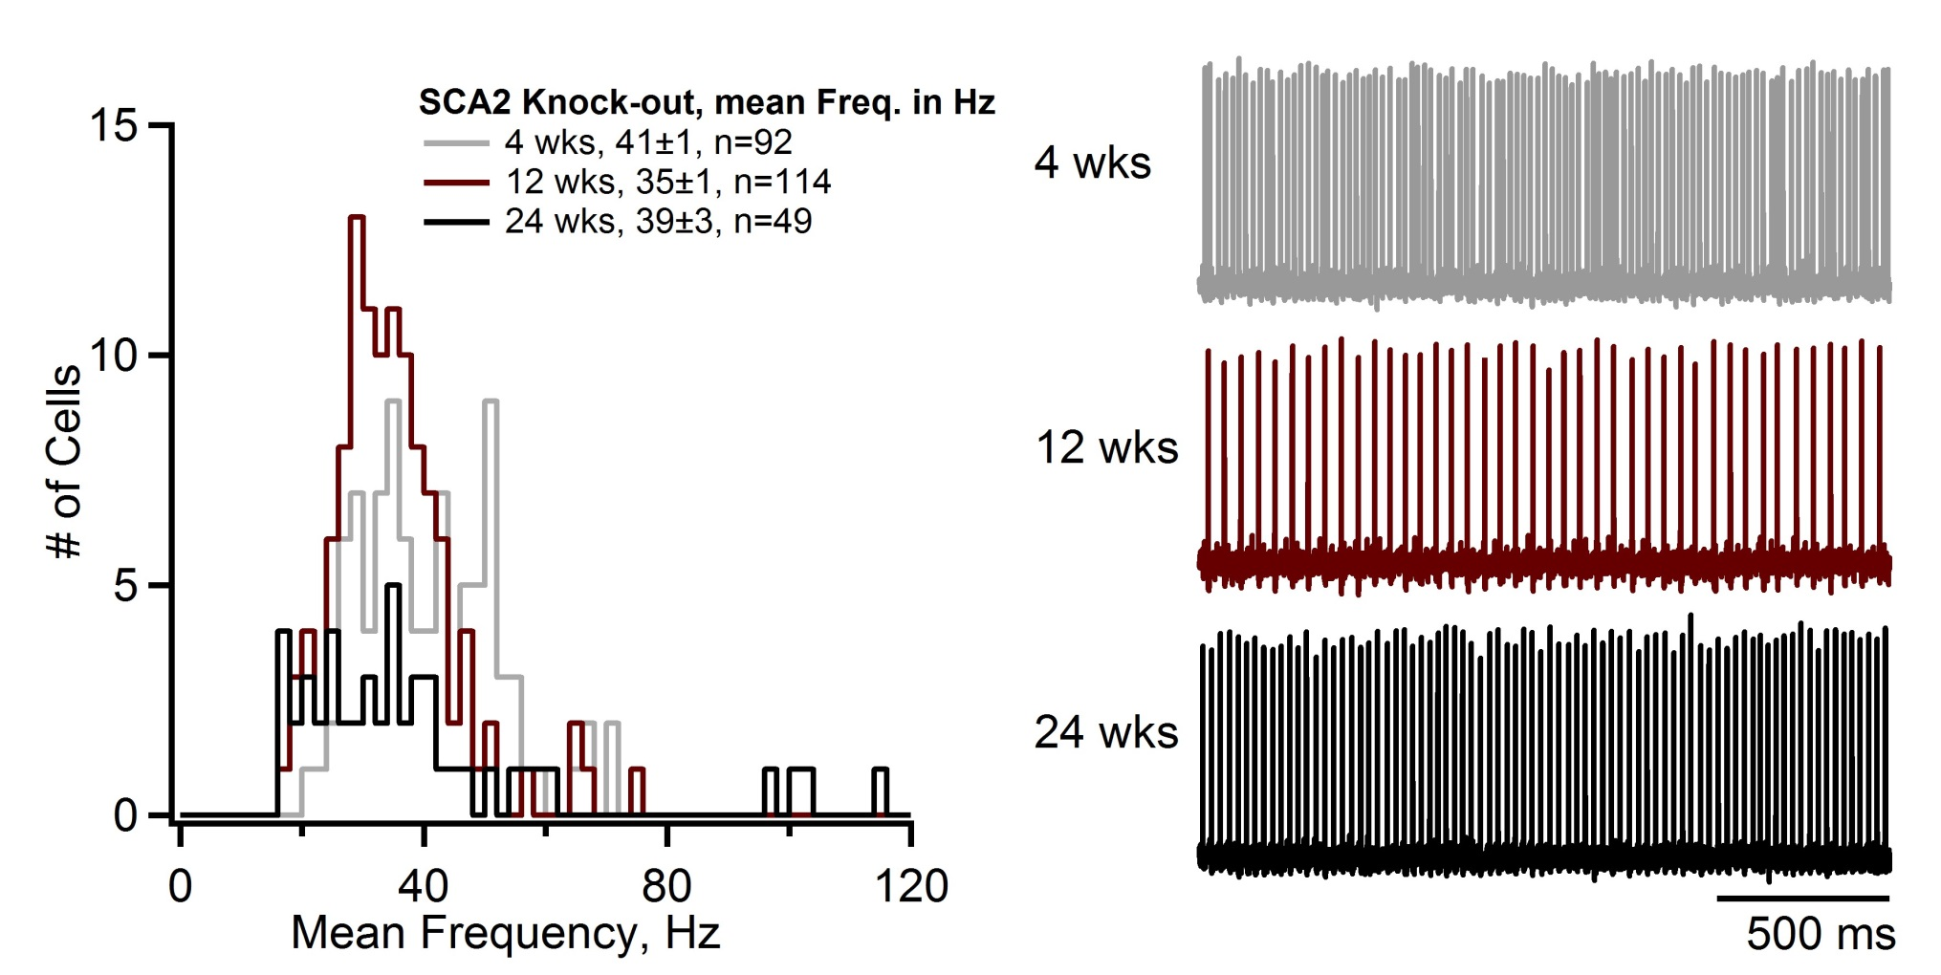
No change in Purkinje neuron frequency in SCA2-KO mice measured at 4, 12 and 24 wks

Slide 11
Purkinje neuron morphology
WT, 7_23_2012
SCA2, 24 wks, 11_29_2011

Slide 12
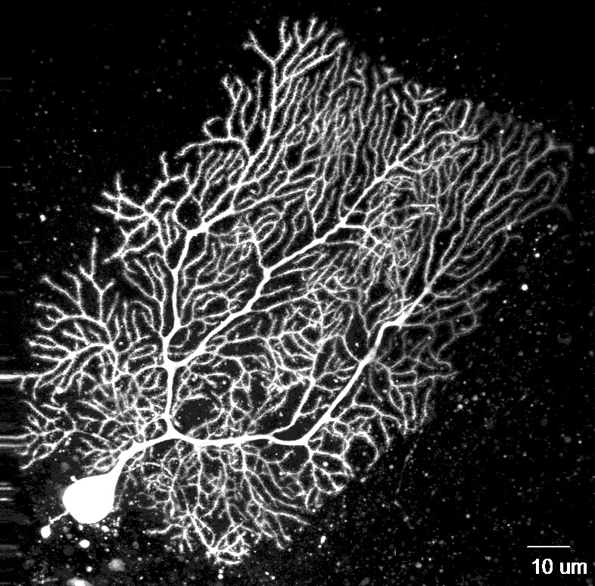
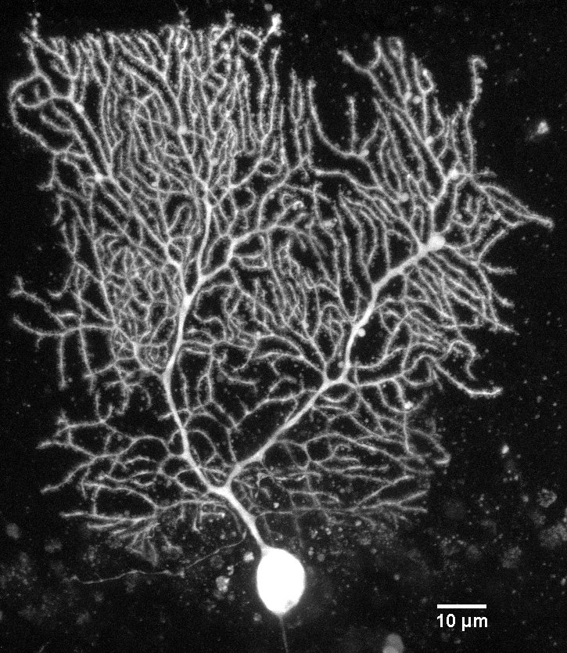
WT, 12_14_2011
SCA2-24 wks, KO, 12_5_2011

Slide 13
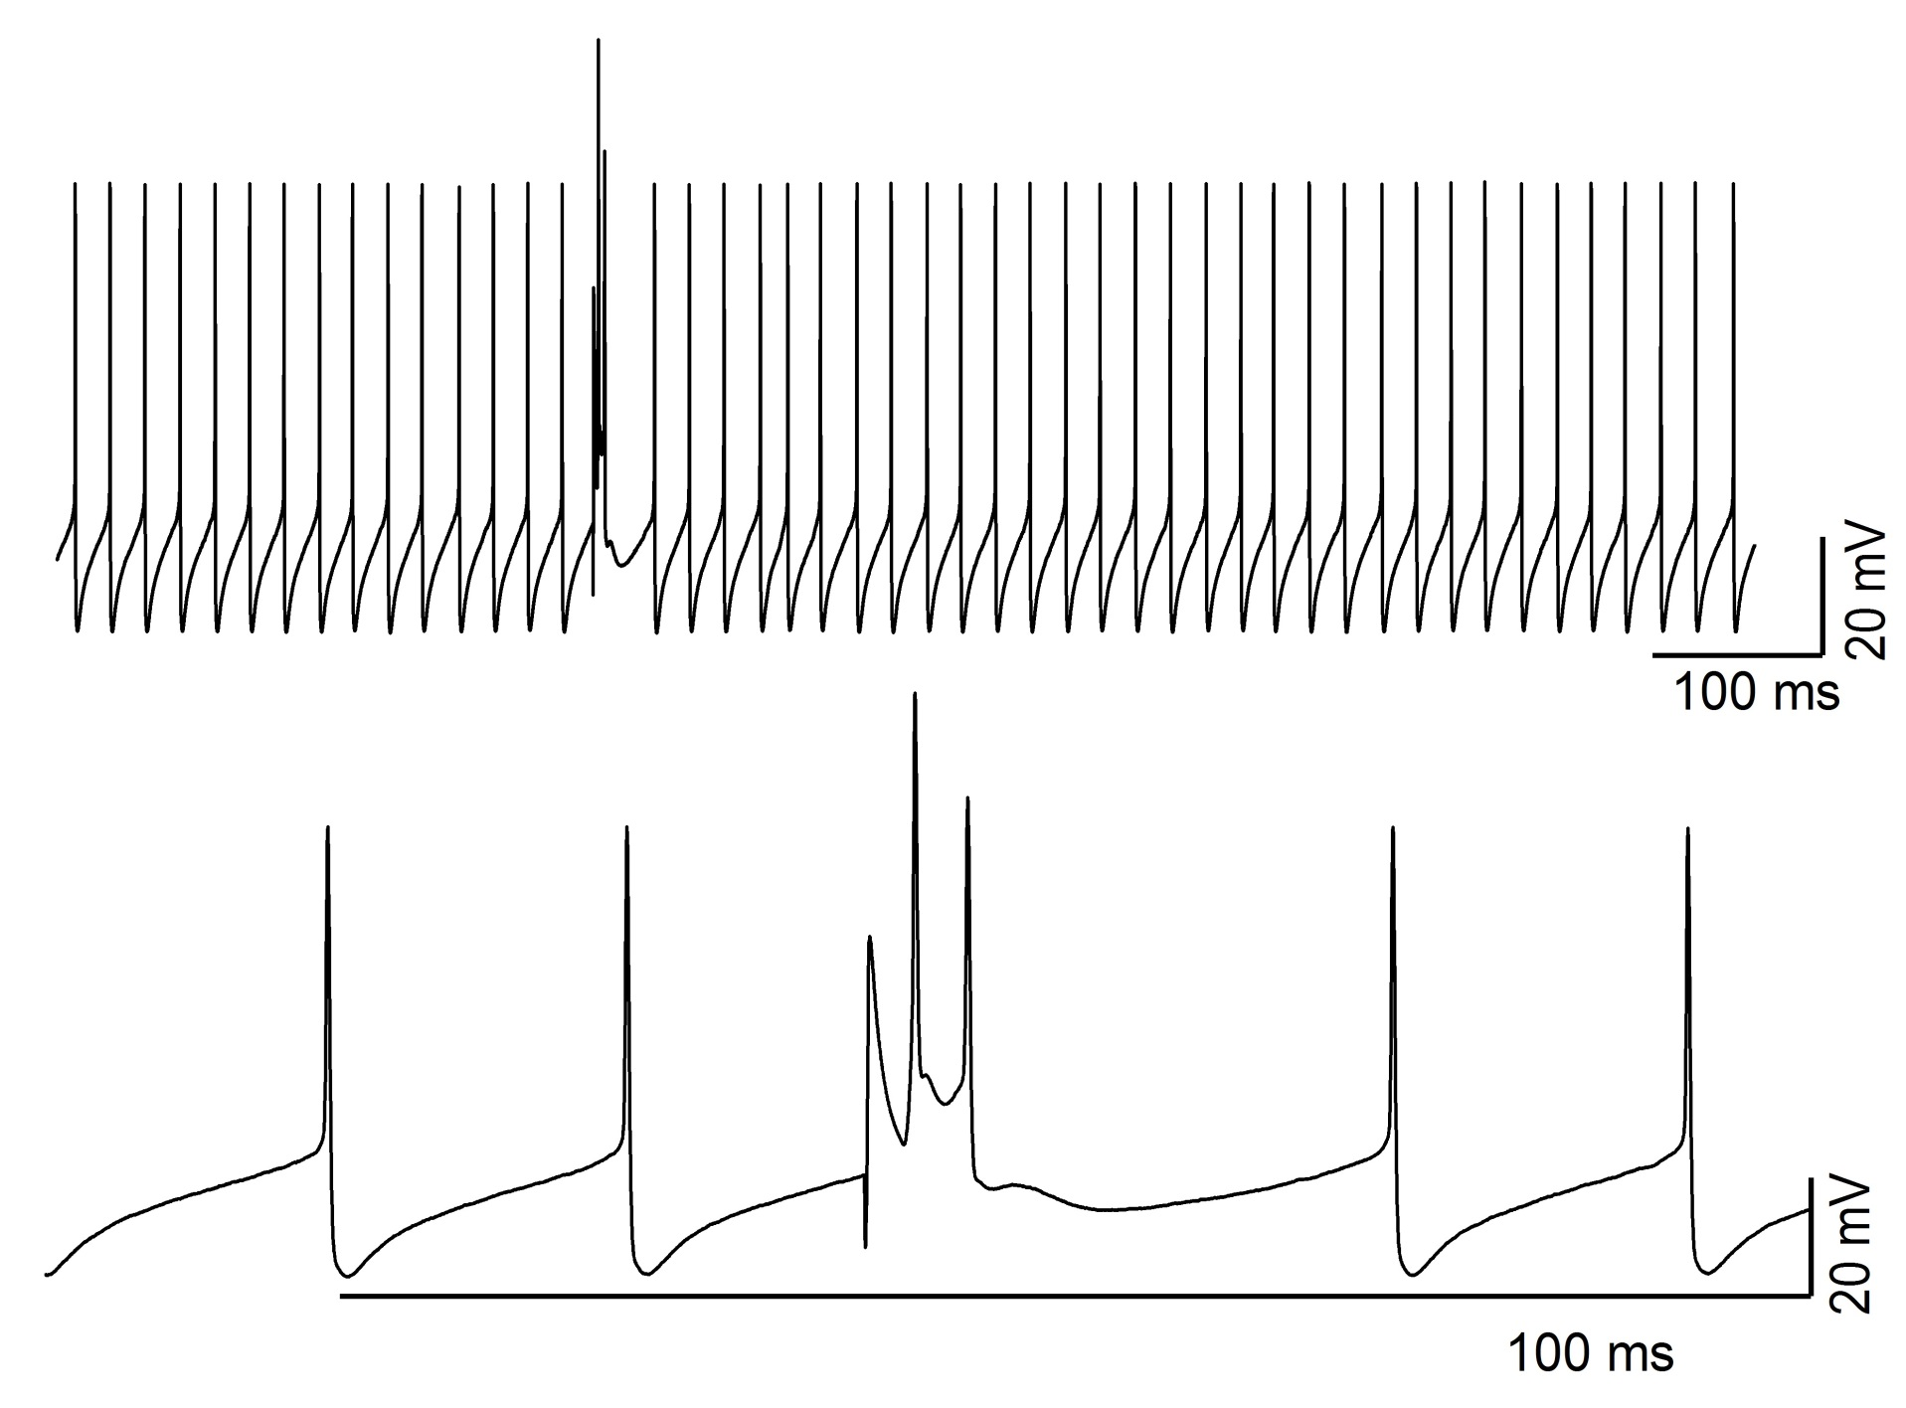
Preliminary study shows no difference in Complex spike

