Slide 1
Q58 Rotarod Trials
2/13/15
- Matthew Schneider

Slide 2
Q58 Rotarod Trials
Received the Q58 mice in an FVB background from the Bezprozvanny lab last year
Bred mice for a rotarod group to verify motor phenotype in our hands
We had not previously seen a rotarod phenotype in this particular background

Slide 3
Q58 Rotarod Protocol
28 Mice – 14 Wt and 14 Tg
7 males and 7 females for each genotype
Tested at 4 months, 6 months, and 8 months
5 day rotarod protocol
Monday – mice are handled
Tuesday – training day
Wednesday, Thursday, Friday – Accelerating rotarod from 0 to 40 rpm in 360 seconds; 3 trials each day
No weight differences between Tg and Wt mice at any of the time points

Slide 4
Q58 Rotarod Results
Data presented using SEM for error bars

Slide 5
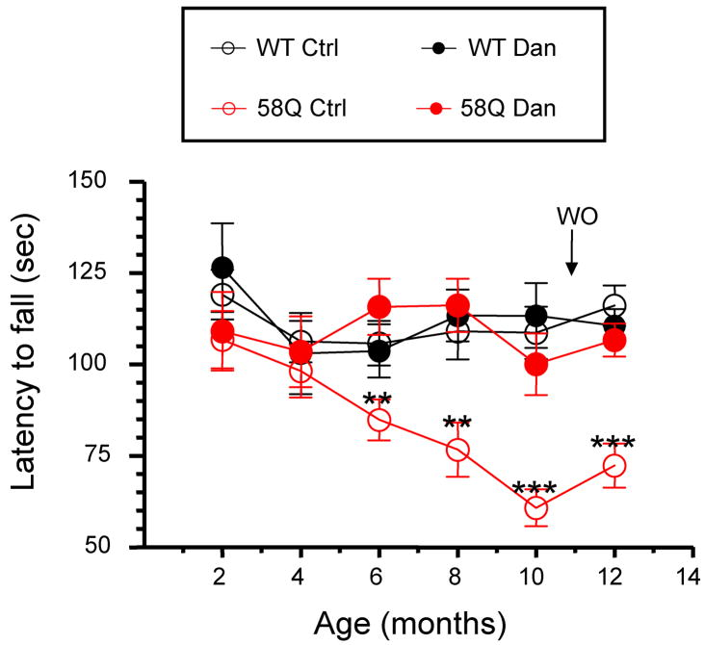
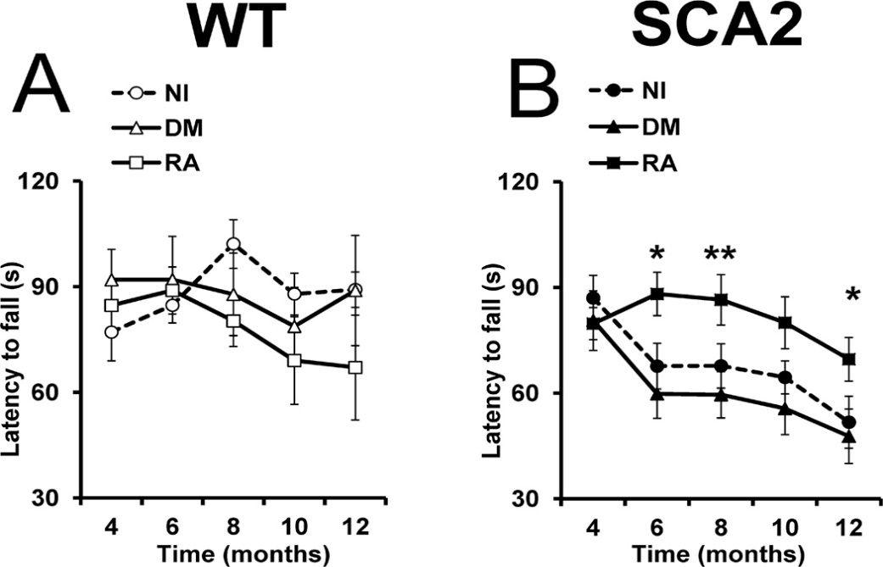
Comparison of the rotarod performance of Q58 mice in our lab to Bezprozvanny’s published data
Liu J, Tang T-S, Tu H, et al. 2009. The Journal of neuroscience : the official journal of the Society for Neuroscience
Kasumu AW, Liang X, Egorova P, Vorontsova D, Bezprozvanny I .2012. The Journal of neuroscience : the official journal of the Society for Neuroscience .
** p < 0.01
SCA2-58Q mice males bred with B6D2 Company females
SCA2-58Q (N6 FVB) males bred with FVB Company females
Only females used
Rotarod Protocol:
Mice are screened at 5 rpm, if they fall off before 5 minutes they aren’t used
Tested for 4 days and results analyzed from day 4 (3 trials/day)
0 – 40 rpm in 200 seconds

Slide 6
Comparison of the rotarod performance of Q58 mice in our lab to Bezprozvanny’s published data
Kasumu A, Hougaard C, Rode F, et al. Novel selective positive modulator of calcium-activated potassium channels exerts beneficial effects in a mouse model of spinocerebellar ataxia type 2. Chemistry & biology 2012
SCA2-58Q (N6+ FVB) males bred with FVB Company females
Animals were 9 months old at experiment start
Rotarod Protocol
Pre-drug feeding: beamwalk, then rotarod, same testing as the first two
Post-drug feeding: Day 1 – beamwalk training
Day 2 – beamwalk testing
Day 3-5 – Rest
Day 6 – rotarod training (3 trials/day)
Day 7 – rotarod testing (3 trials/day)

Slide 7
ITPR1 ASO Work
From a pool of ASOs we received the two most promising based on in-vitro work
Injected the ASOs into mice to determine possible ITPR1 knockdown

Slide 8
Itpr1 ASOs lower Itpr1 mRNA abundance
N=3 males and 3 females per treatment
All wildtype mice
Mice were 5 months old
250 μg ASO treated for 7 days
qPCR results shown

Slide 9
Q72 BAC Mouse
Rotarod Behavioral Testing

Slide 10
Q72 BAC Mice
Tested to verify rotarod phenotype with new protocol and different mouse background
28 Mice – 14 Wt and 14 Tg
7 males and 7 females for each genotype
Tested at 12 weeks of age
5 day rotarod protocol
Monday – mice are handled
Tuesday – training day
Wednesday, Thursday, Friday – Accelerating rotarod from 0 to 40 rpm in 360 seconds; 3 trials each day

Slide 11
Q72 BAC Differences
Significant weight differences between Wt and Tg Mice
Tg mice were visibly more active (‘bouncy’)
*
*
*
* P < .001
Error bars = SD

Slide 12
Rotarod Performance Results Cont.
*
*
*
* P < .001
Error bars = SEM

