Slide 1
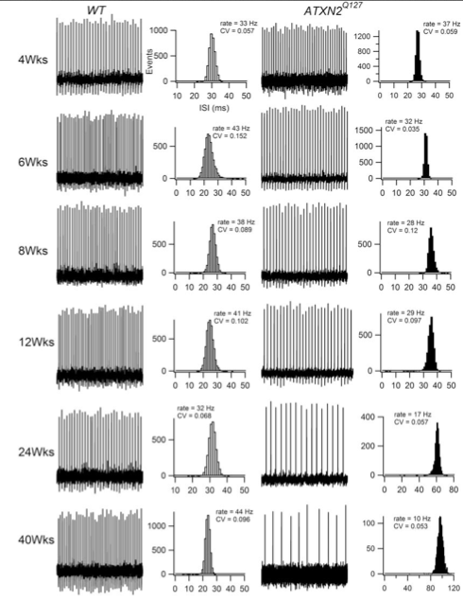
Age dependent reduction of Purkinje cell firing frequency in Q127 mice.
AGE
Hansen et al., 2012

Slide 2
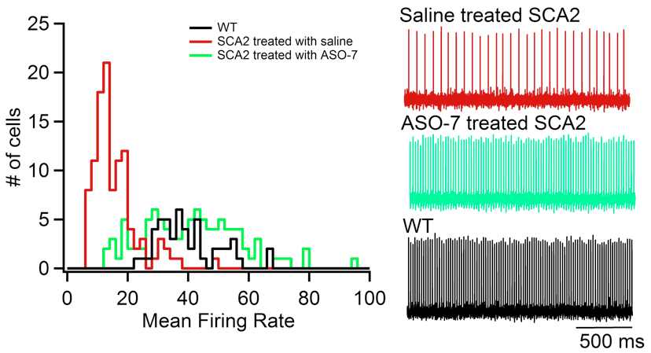
Neurophysiological phenotype of Q127 mice treated with ASO216 13 weeks
Tom Otis and Meera Pratap, UCLA
Mice Neurons Mean
2 107 16±1 Hz
2 102 42±2 Hz
1 50 40±1 Hz
MATT2

Slide 3
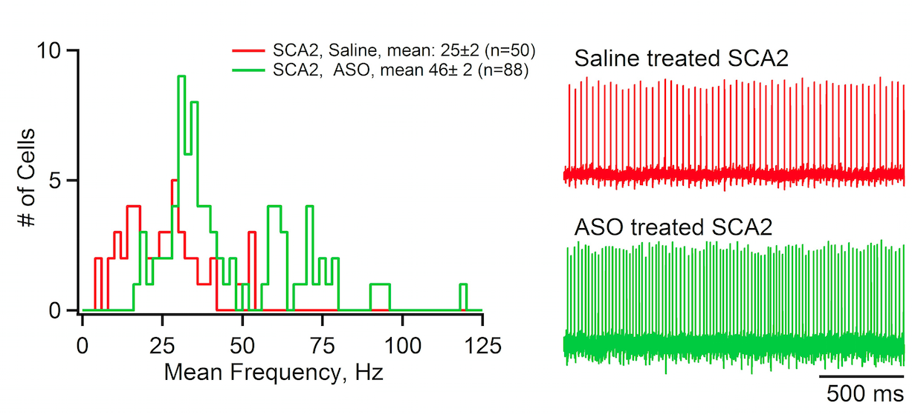
Neurophysiological phenotype of Q127 mice treated with ASO216 5 weeks
Tom Otis and Meera Pratap, UCLA
MATT4

